Slide 1
Open Institutional Publishing: ‘Walking the Walk’
Sarah Thompson, Assistant Director: Content and Open Research
OIPA Symposium – 10 June 2024

Slide 2
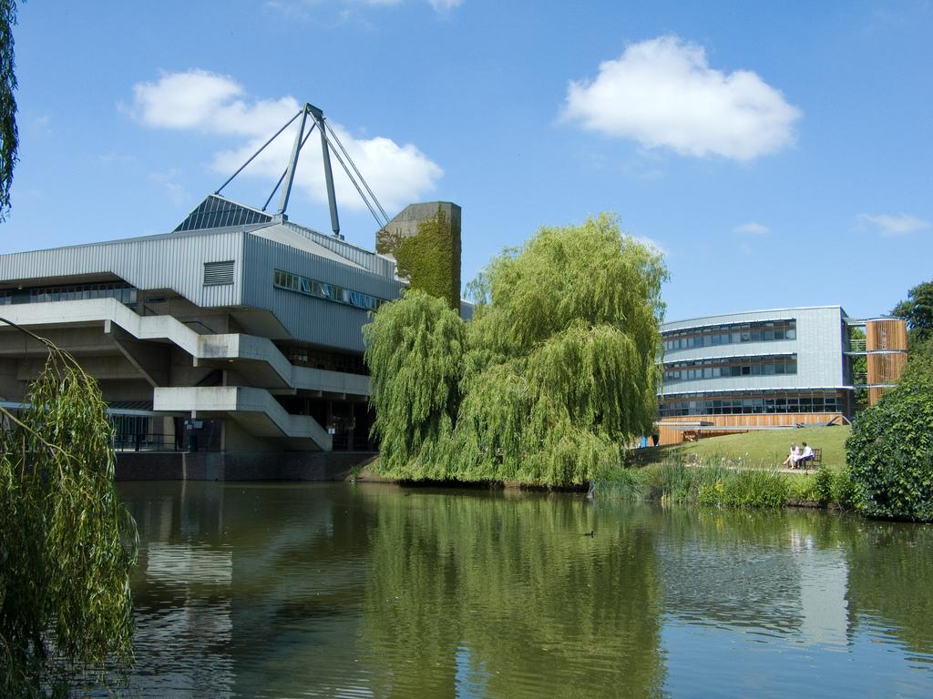
About the University of York
Founded 1963
“A University for Public Good”
19,850 FTE students
30+ departments, schools and research centres in humanities, social sciences, science; 3 faculties
Focus on both teaching and research
Member of Russell Group; White Rose Consortium; N8 Research Partnership; Worldwide Universities Network
Notes:
York is a research intensive university, but it is also teaching focused, which means our content, collections and services have to support both teaching and research across the humanities, social sciences, science and medicine. When it comes to content we need both breadth and depth – resourcing this is an ongoing challenge because we are not a particularly big university compared to our peers in the sector.
The University defines itself as A University for Public Good in its strategic vision, which is a useful steer for us as we prioritise our activities.

Slide 3
Library Strategic Roadmap
In response to the University strategy, and its vision of York as a University of Public Good, we have reaffirmed our commitment to open
Open Research
Provide leadership and expertise in open research at the university, and work collaboratively with the wider sector to develop and support sustainable open research initiatives and infrastructure
Open Access Publishing
Have an even stronger focus on supporting open access publishing and open educational resources, and invest in the development of White Rose University Press and repositories
Notes:
The University of York launched its new strategy just over a year ago, in October 2021, which includes a clear vision for itself as a University for Public Good. Since then, the Library has created its new roadmap and taken the opportunity to reaffirm our commitment to Open. There are two quotes here from our Library roadmap. One pledges to continue the leadership role we’ve been taking to establish a culture of open research at the university, working collaboratively across the sector as we do so. The second promises we will have an even stronger focus on supporting OA publishing and open educational resources, and that we will invest in the further development of our shared university press and OA repositories.
We have made a clear and deliberate effort to place Open at the centre of what we do.
We’ve developed an Action Plan to help us take forward our roadmap – for OER we intend to develop an institutional policy, support and infrastructure, none of which currently exist at York.

Slide 4
Open Research

Slide 5


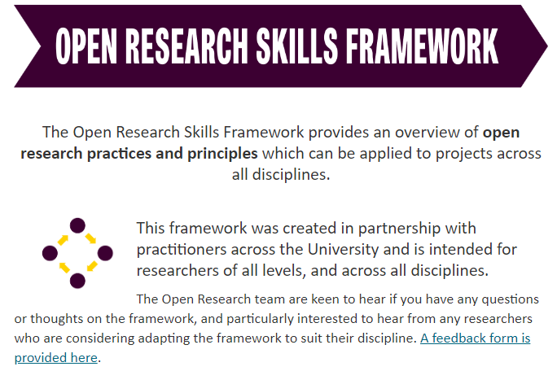

York’s commitment to open research
Notes:
The University has pledged its commitment to the values, principles and culture of open research in a statement which the Library helped to create. Since that statement was launched in May 2020, we’ve led a number of initiatives promoting open research, for example: an advocates network of practitioners, a good practice awards scheme and – most recently – a skills framework which can be applied to research methodologies across all disciplines.

Slide 6
Open Research leadership and the pivotal role of the Library
Advocacy
Engaged with open research in different ways
Have become trusted experts
Have strategic influence as a result
LEADERSHIP
Compliance
Expertise

Slide 7
Open Access Publishing

Slide 8
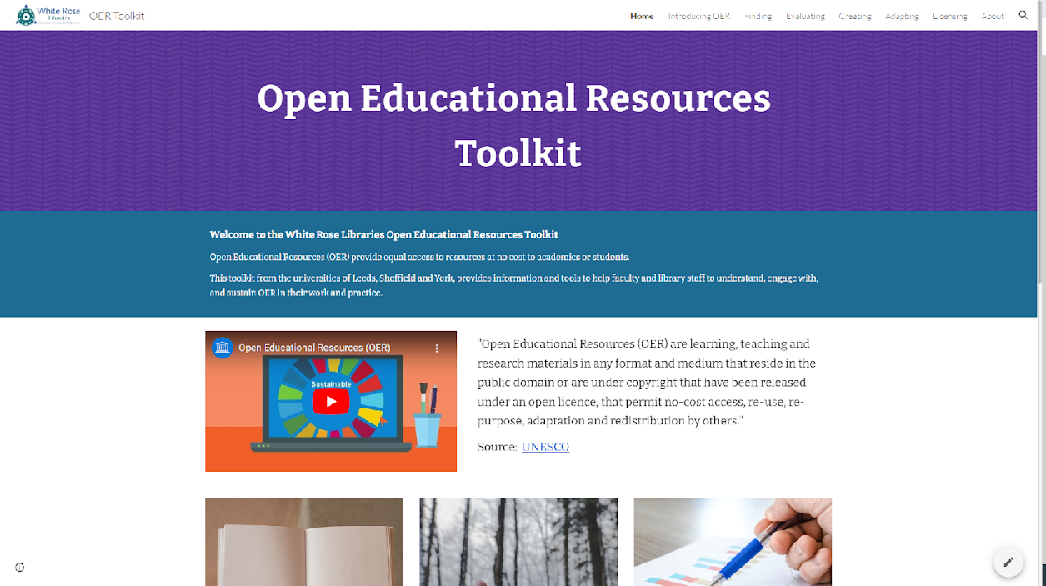
White Rose Libraries OER Toolkit
Notes:
Toolkit: https://sites.google.com/york.ac.uk/oertoolkit/home
We have a successful track record of working with our White Rose Library partners – the universities of Leeds and Sheffield – to develop new services. Firstly by creating our shared institutional respositories (White Rose Research Online and White Rose Etheses Online), then through our shared press, White Rose University Press which is a fully open access publisher. We also collaborate on projects.
Last year we worked on an OER project together. Like most academic libraries we think that open textbooks, and open educational resources more broadly, should be a more affordable and sustainable way to deliver teaching and learning content to students. We are all aware of the high cost and restrictive licences applied to books that commercial publishers sell as textbooks. But persuading academic colleagues to use, adapt or create open educational resources seems like a big challenge to us. We therefore embarked on this project to get us started; the main goals of the project are listed here.
Main concerns raised in the UX interviews were: Publishing – Storage – Time – Recognition – Compensation

Slide 9

White Rose University Press
A fully Open Access library-led academic publisher
Publishes research monographs and journals (and want to publish textbooks)
Scope and strategy set by library-led Management Board
Commissioning by an academic-led Editorial Board, based on peer review
Offer support for OA more widely, through local sessions and advice for academics wanting to engage with OA, and initiatives such as the Jisc New University Press toolkit and the (new) Open Institutional Publishing Association
Notes:
At York we support open access publishing in a number of ways. One is by running our own fully open access press – White Rose University Press – in partnership with the universities of Leeds and Sheffield. Our monographs are currently funded through BPCs, which are paid either by a funder or (for academics from York, Leeds and Sheffield) the respective library.
Quality and rigour is very important to us and everything we publish is peer reviewed.
Our Press also offers wider support for open access, and is a source of advice for academics at our 3 institutions as well as being active in the sector and contributing to initiatives like the Jisc New University Press toolkit.
So, why did the 3 White Rose Libraries want to set up our own press in the first place? A key element was wanting to be in a position to support academics in the area of open access from a position of experience, and be able to offer practical guidance and expertise – we are seeking to influence and affect change that way, to lead the way by Doing – at our own institutions and across the sector.

Slide 10

Key Challenge #1: Building a reputation
Time
Academic Culture
Misunderstandings
Prestige
Mistrust
Notes:
Concerns about OA monographs
Disciplinary differences in research culture and open research practices
Misunderstandings (BPCs are the only model they have heard of)
Mistrust in untried and untested publishers
Worried about loss of prestige, and REF requirements
Comfortable with the status quo, why change

Slide 11

Key Challenge #2: OA revenue models
We are not for profit
We are subsidised by our university libraries
We want to grow but stay small
We operate on a per-project basis
We aim to diversify our revenue streams

Slide 12
Financial Planning

Slide 13

Do our Actions and Decisions reflect our Values?
Notes:
As a library service, we are clearly leading and developing open research services at York.
But: Do our other Actions and Decisions reflect our Values and the values of our parent institutions? Or would an outsider looking in see fractures and disconnections?
For example, what does where and how we spend our budgets say about us?

Slide 14




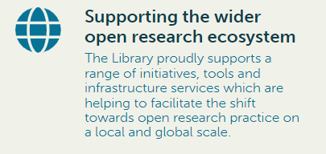

Decision Making Guided by Principles
Notes:
What does this shift to new and varied ways of funding publications, in additional to purchasing books, mean for library budgets? How can we create some headroom to support different models when there are always such competing demands for resources? Well, it definitely requires budget holders to shift their thinking and find ways to ensure that there is alignment between the types of resources you purchase and your strategic direction. We all need to adapt. For example, funding book processing charges has been a challenge for me because it means committing to spend money without necessarily knowing when the book will be published – it could be in a future financial year, and it is not uncommon for publication dates to slip.
It also means making a strategic case to use your existing funds to support diamond models of open access publishing – and to be more vocal within your institutions about the strategic choices you are making, and why.

Slide 15

…Even when under pressure
Developing a principles-led purchasing strategy for ALL library content
Financial challenges providing an immediate test of our new approach
Pragmatism combined with Principles
Greater clarity for our academics AND for publishers / suppliers
Notes:
Photo by Conny Schneider on Unsplash

Slide 16

Bibliodiversity
Notes:
It’s in the long-term interest of the academy to ensure there continues to be a vibrant and diverse range of academic book publishers which truly reflect the variety of scholarship being carried out. If libraries do not financially support different publishers and different business models, there is a risk of market consolidation featuring publisher takeovers and an increasing emphasis on the Book Processing Charge as the main model for publishing open access books. We don’t want to create a highly consolidated, high profit marketplace for academic monographs.
Librarians need to lead conversations about this within their own institutions, and to encourage authors to think carefully about the publication choices they make.

Slide 17

Transparency
Notes:
As a librarian, I want to support the venues my academics want to publish in. In return, I would like to see much more openness and transparency from publishers about their charges. If they charge BPCs, please provide information about the different elements that make up these fees, so that authors can make informed choices by considering cost as well as services and publisher reputation. If a publisher is not for profit, what information do they provide about their financial stability and governance model?
The better informed we all are about the costs of book publishing, the better our chances of working together to create a fair and sustainable system.

Slide 18
Operationally Open

Slide 19

Library Teams & Structures
To what extent do library teams focus on both open and paywalled content? How is this changing?
To what extent do library staff understand the transition (to open) that is taking place? How do you ensure they are kept informed and engaged?
How is the transition (to open) changing perceptions your user communities have about the library?
Are library staff able to talk confidently to academics about their requirements for both accessing and producing content?
Notes:
Libraries also need to turn that reflective lens inwards. Are those of us in leadership and management positions in libraries doing enough to advocate for, and respond to, change in this area – not just in how we support our students and academic staff, but in how we CHANGE our libraries? In other words, are we walking the walk as well as talking the talk? For example…

Slide 20

Library Policies and Processes
Do your collections policies apply to open content?
Do you know what proportion of your budget is spent on open content vs paywalled content?
Do library staff spend time selecting open content and ensuring it is discoverable?
Notes:
Are we finding ways to direct the development of our library collections and make strategic choices about open content? For example…

Slide 21

Sarah Thompson | s.thompson@york.ac.uk
@sarah_thomp5263

