Slide 1
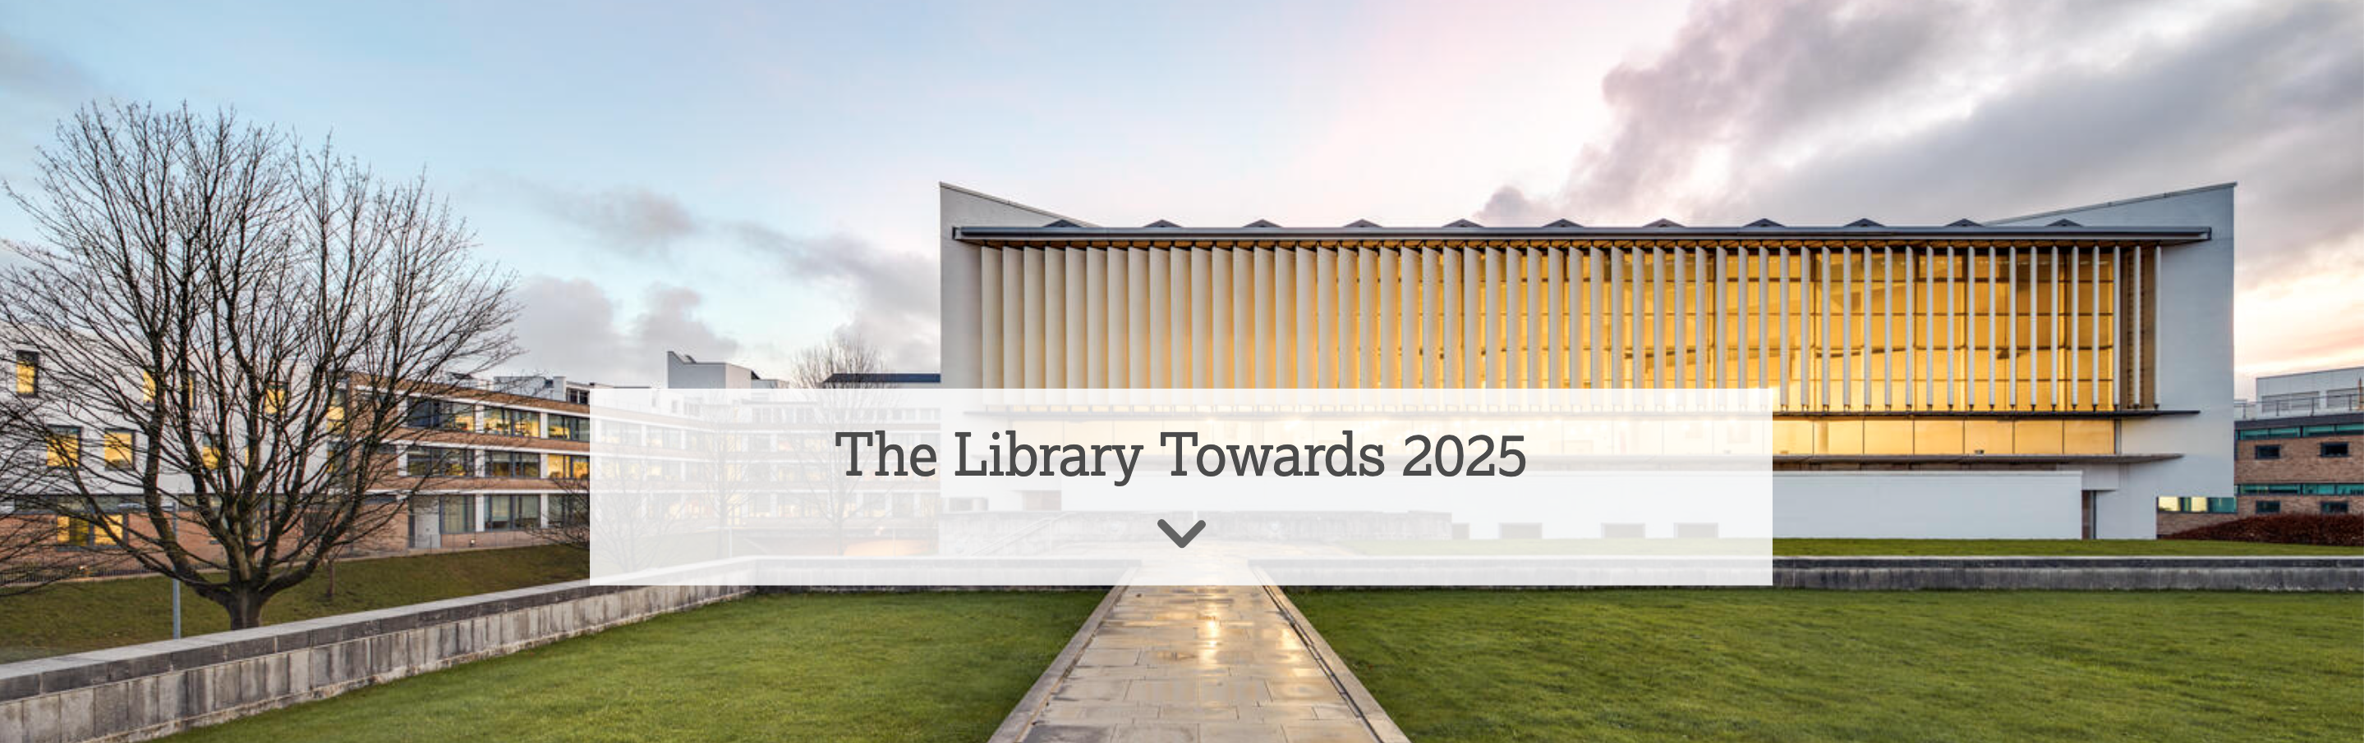

Trailblazing
Or How the Academic Library Reinvented Itself Thanks to Open Access
Andrew Barker: lIBRARY dIRECTOR, lANCASTER uNIVERSITY

Slide 2
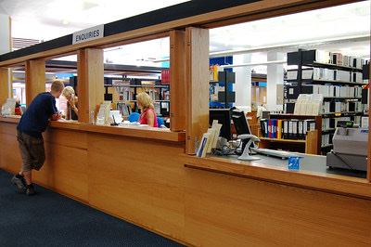
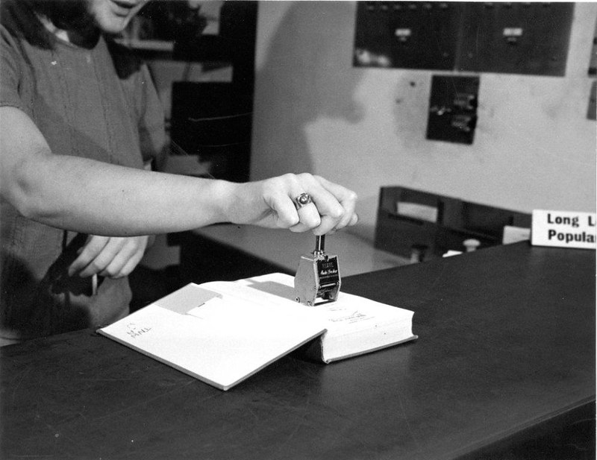
OUR Library Vision – From Service…

Slide 3

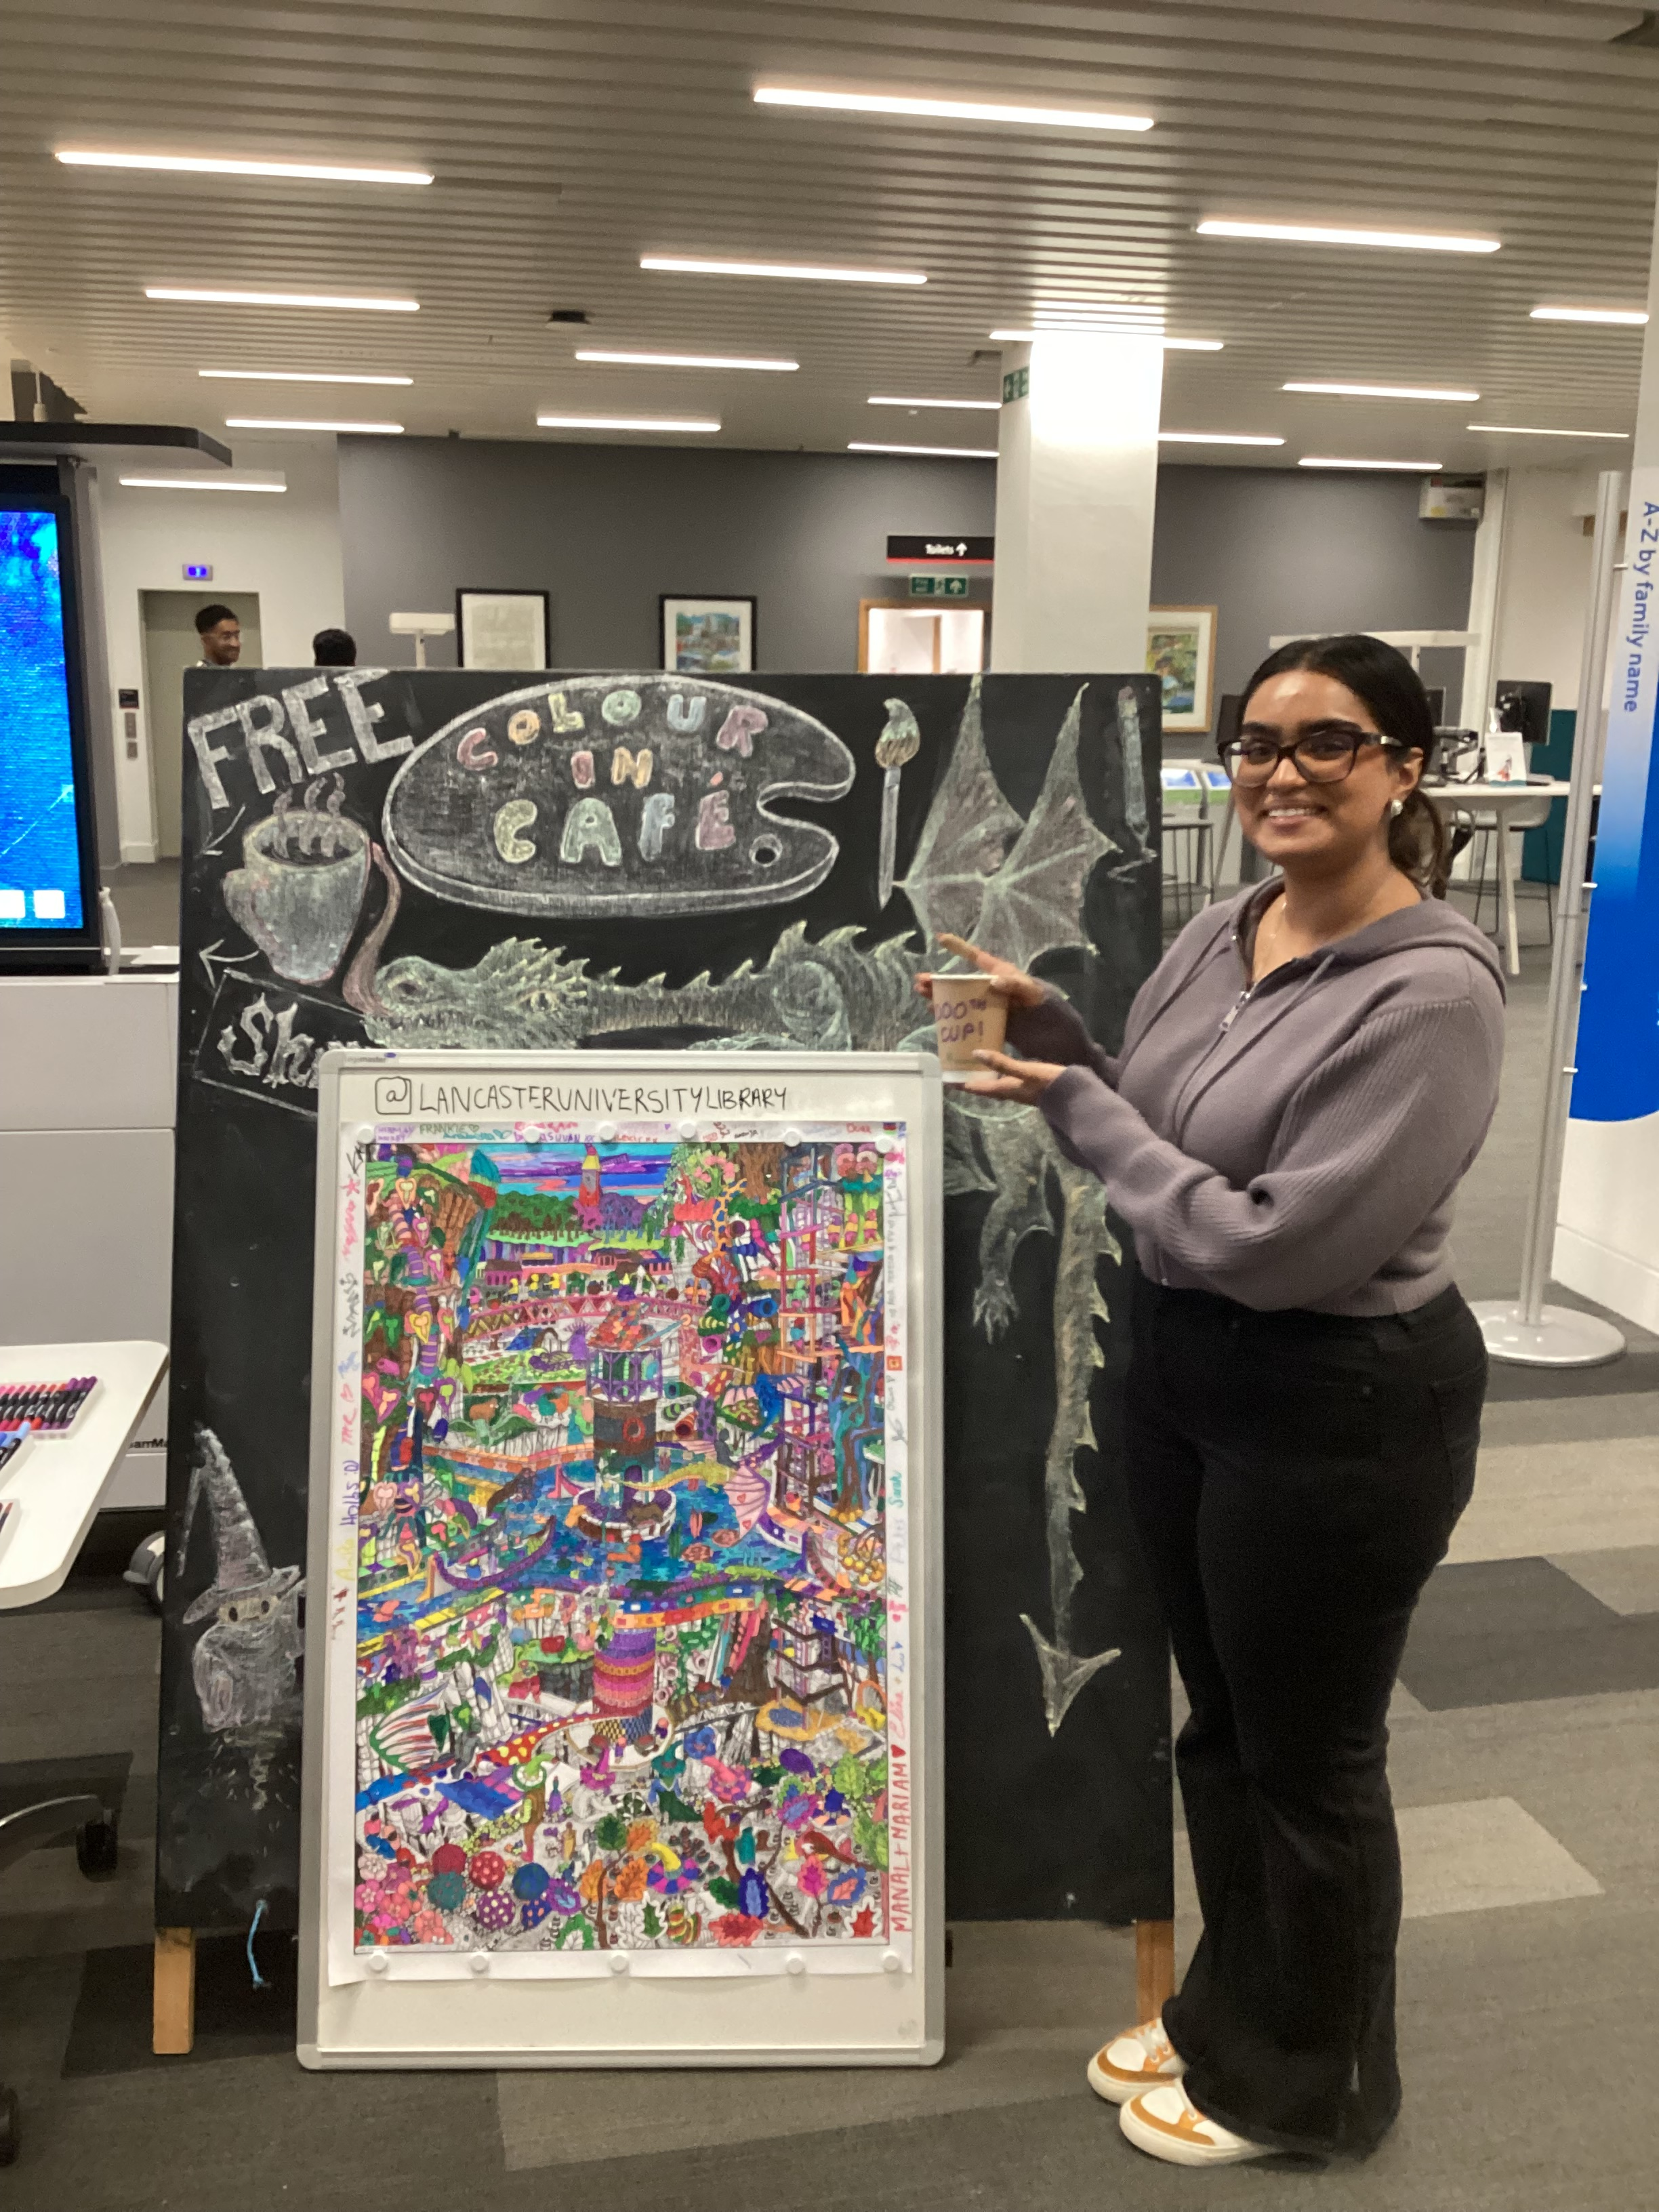
Our Library Vision – To Partner…

Slide 4
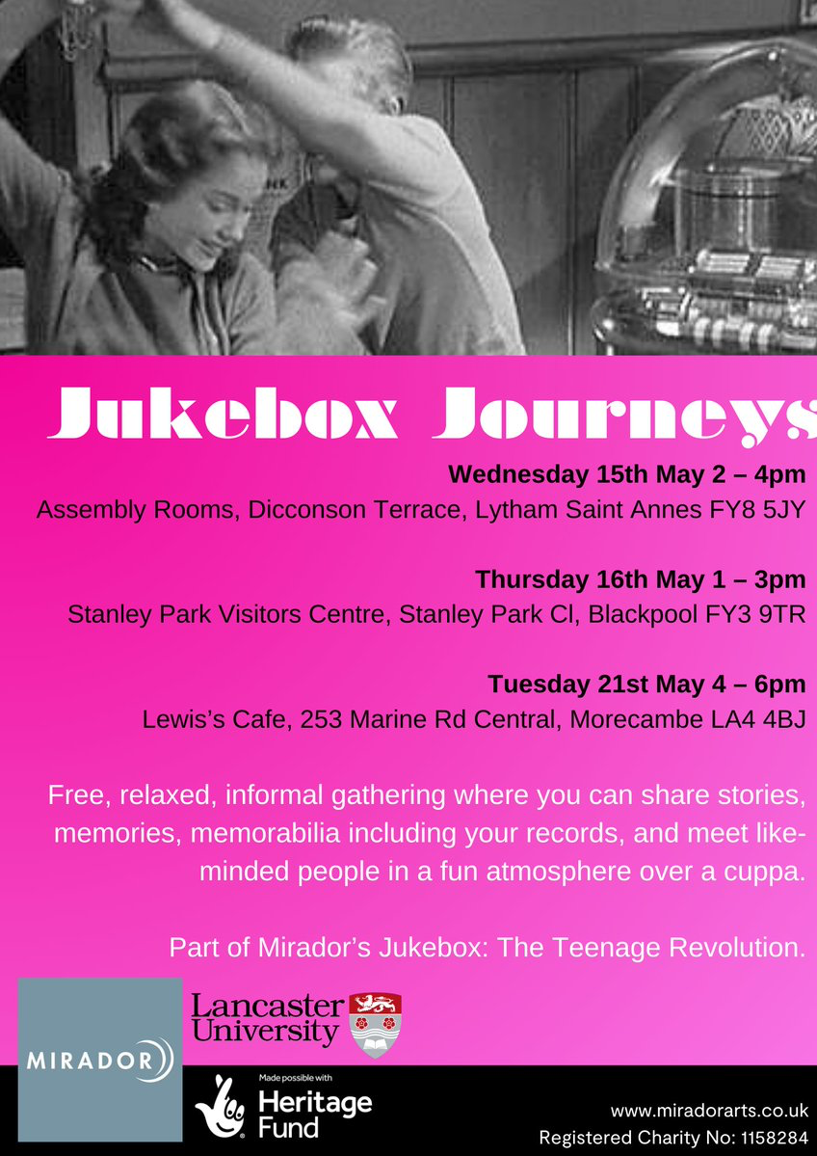

Our Library Vision – To Partner…

Slide 5
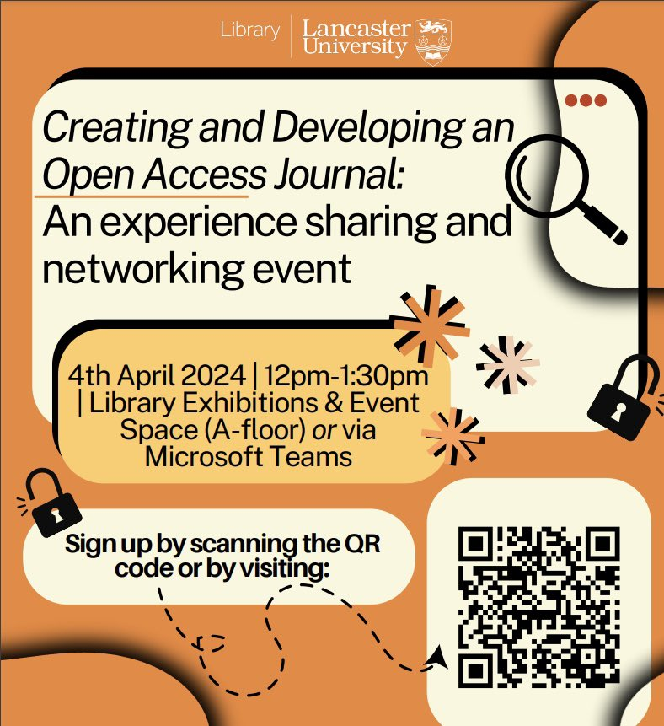
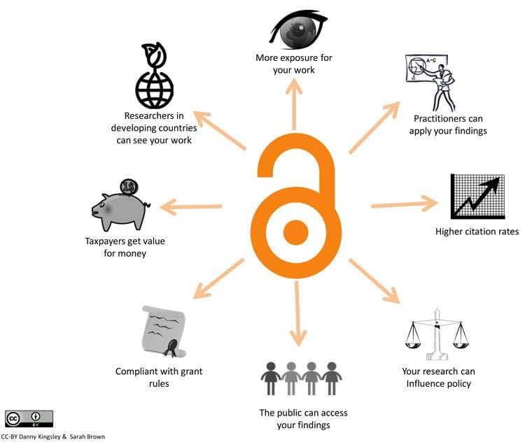
How did we get there? OA at LU

Slide 6
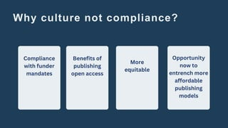
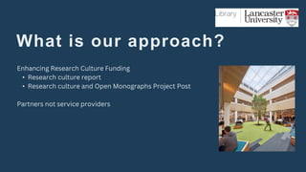
Where are We Now? OA Monographs
(Slides Courtesy of Tom Morley)

Slide 7
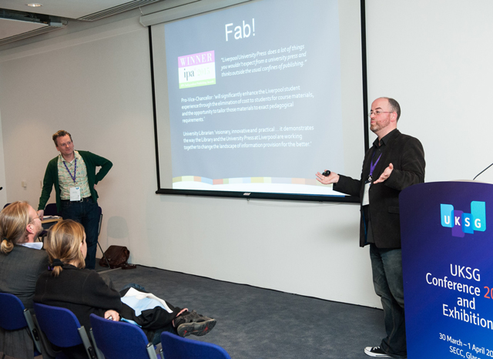
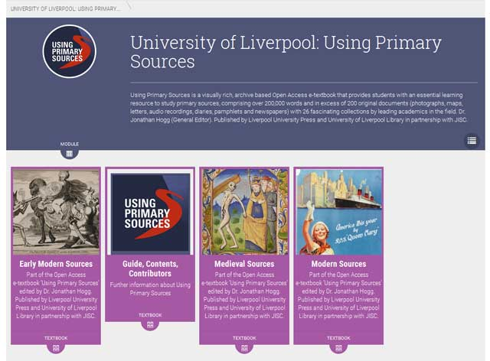
This is Personal: The Institution as E-textbook Provider

Slide 8

Open Book Futures Partnership

Slide 9
Trailblazers

Slide 10

Trailblazers: What’s It all about?

