Slide 1

Supporting students at our institution
Pat Gordon-Smith
Commissioning Editor

Slide 2
UCL Press publishes research scholars from any institution (or none), at any point in their career, based anywhere globally, in the following outputs:
UCL LIBRARY SERVICES
Scholarly monographs
Edited collections
Short monographs
Textbooks
14 Academic journals
UCL OpenEnvironment journal
Our scope excludes publication of research students’ work.
But we have other ways of supporting their development and contributing to UCL’s institutional responsibilities towards them

Slide 3
UCL LIBRARY SERVICES
1 Student-led journals
Our biggest permanent service for students
Any student body in any faculty can run a journal
  Must have faculty support
  One issue per year
  Student editors plan, manage, produce and market the journal
UCL Press service
  Ring-fenced funding from UCL at start up in 2017
  First published on Open Journals System, now on Janeway alongside our journals
  Substantial work for UCL Press journals & production; some on start up and transfer to Janeway
  UCL Press support
    New student journals: editorial teams introduced to journals best practice, system set up, generic workflow (article templates, etc.)
    And that’s it, apart from…
    The Wild West – intermittent crisis management (e.g. same DOI used for multiple articles)
    These problems now rare on the more robust Janeway system

Slide 4
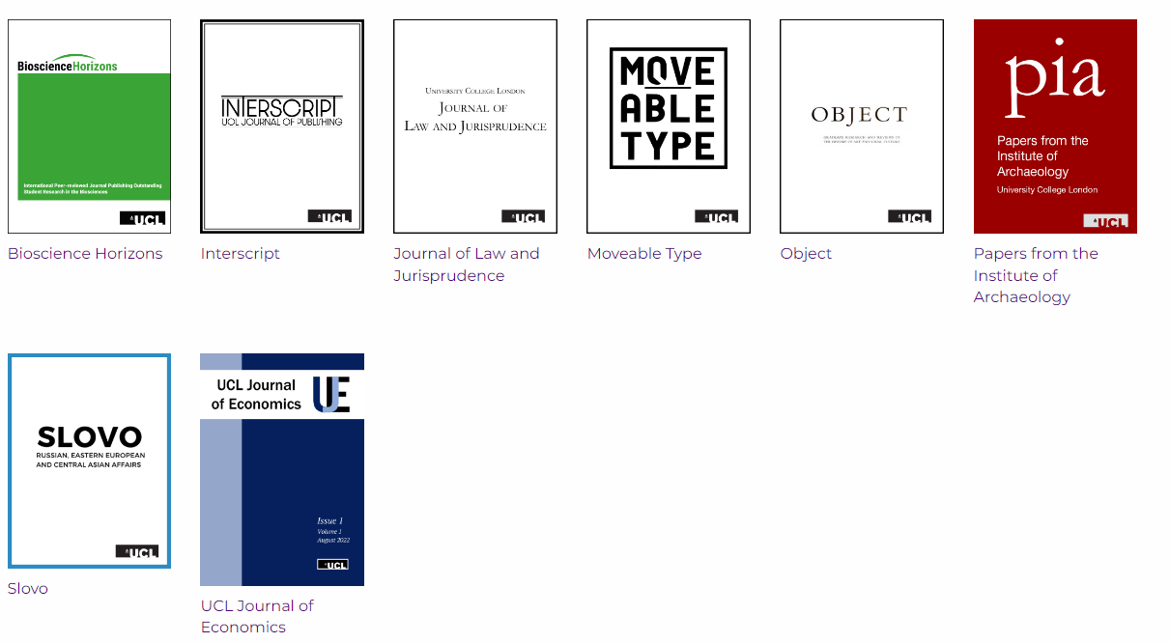
Current student journals
We don’t collate stats for student journals, but…
Some have been indexed in Web of Science, Scopus and other subject-specific indexes.
Some print their issues (faculty provide budget for this, or students fund raise to cover this additional cost).
These achievements all managed by the students.

Slide 5
2 Student members on London Review of Education editorial board
Official publication of UCL Institute of Education (IOE)
Inclusion of IOE doctoral students as board members initiated in 2014
Recruited, interviewed and supported by the editorial board and UCL Press journals team
Students serve terms of up to 3 years; three terms completed so far, two by pairs of students
Positive results for the students, the journal and UCL
  Student co-editors on 4 special issues, alongside academic board members
  Two of these were ideas from the students that would not otherwise have emerged
  Equal voice at the table with board members who range from ECR to professor
  One previous student member full academic member book reviews editor following doctorate
  LRE included in IOE community statement for REF 2021

Slide 6
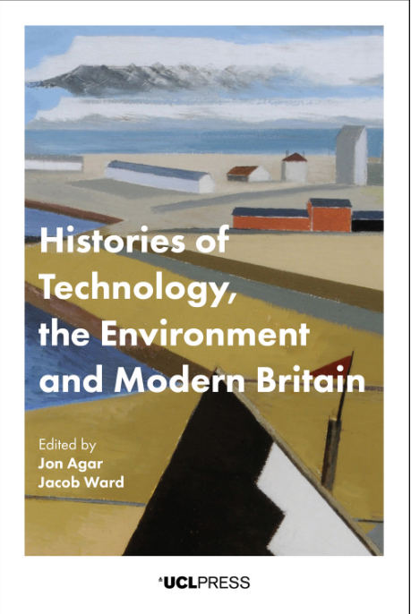


3 Thesis to monograph presentations + others
Outreach to prospective UCLP authors, resulting in excellent books enabled by our funding model as they became staff:
2018
28,434 DL
170 countries
2023
20,063 DL
146 countries
2023
4,060 DL
85 countries
20% in India / Pakistan
Also for students to take wherever they go, extending work of our Academic Writing Centre
Open to ad hoc departmental presentations / collaborations to support modules, for undergraduates as well as research students

