Slide 1
Using the Manifold platform for
UoL Press books

Slide 2
The Manifold platform
Open access scholarly publishing platform created by the University of Minnesota Press with CUNY and Cast Iron Coding.
Enables publication of enhanced, networked, media-rich and interactive versions of books that offer authors and readers an innovative way of writing and engaging with texts.
UoLP launched own instance of Manifold in September 2023, with support from the Manifold team.

Slide 3
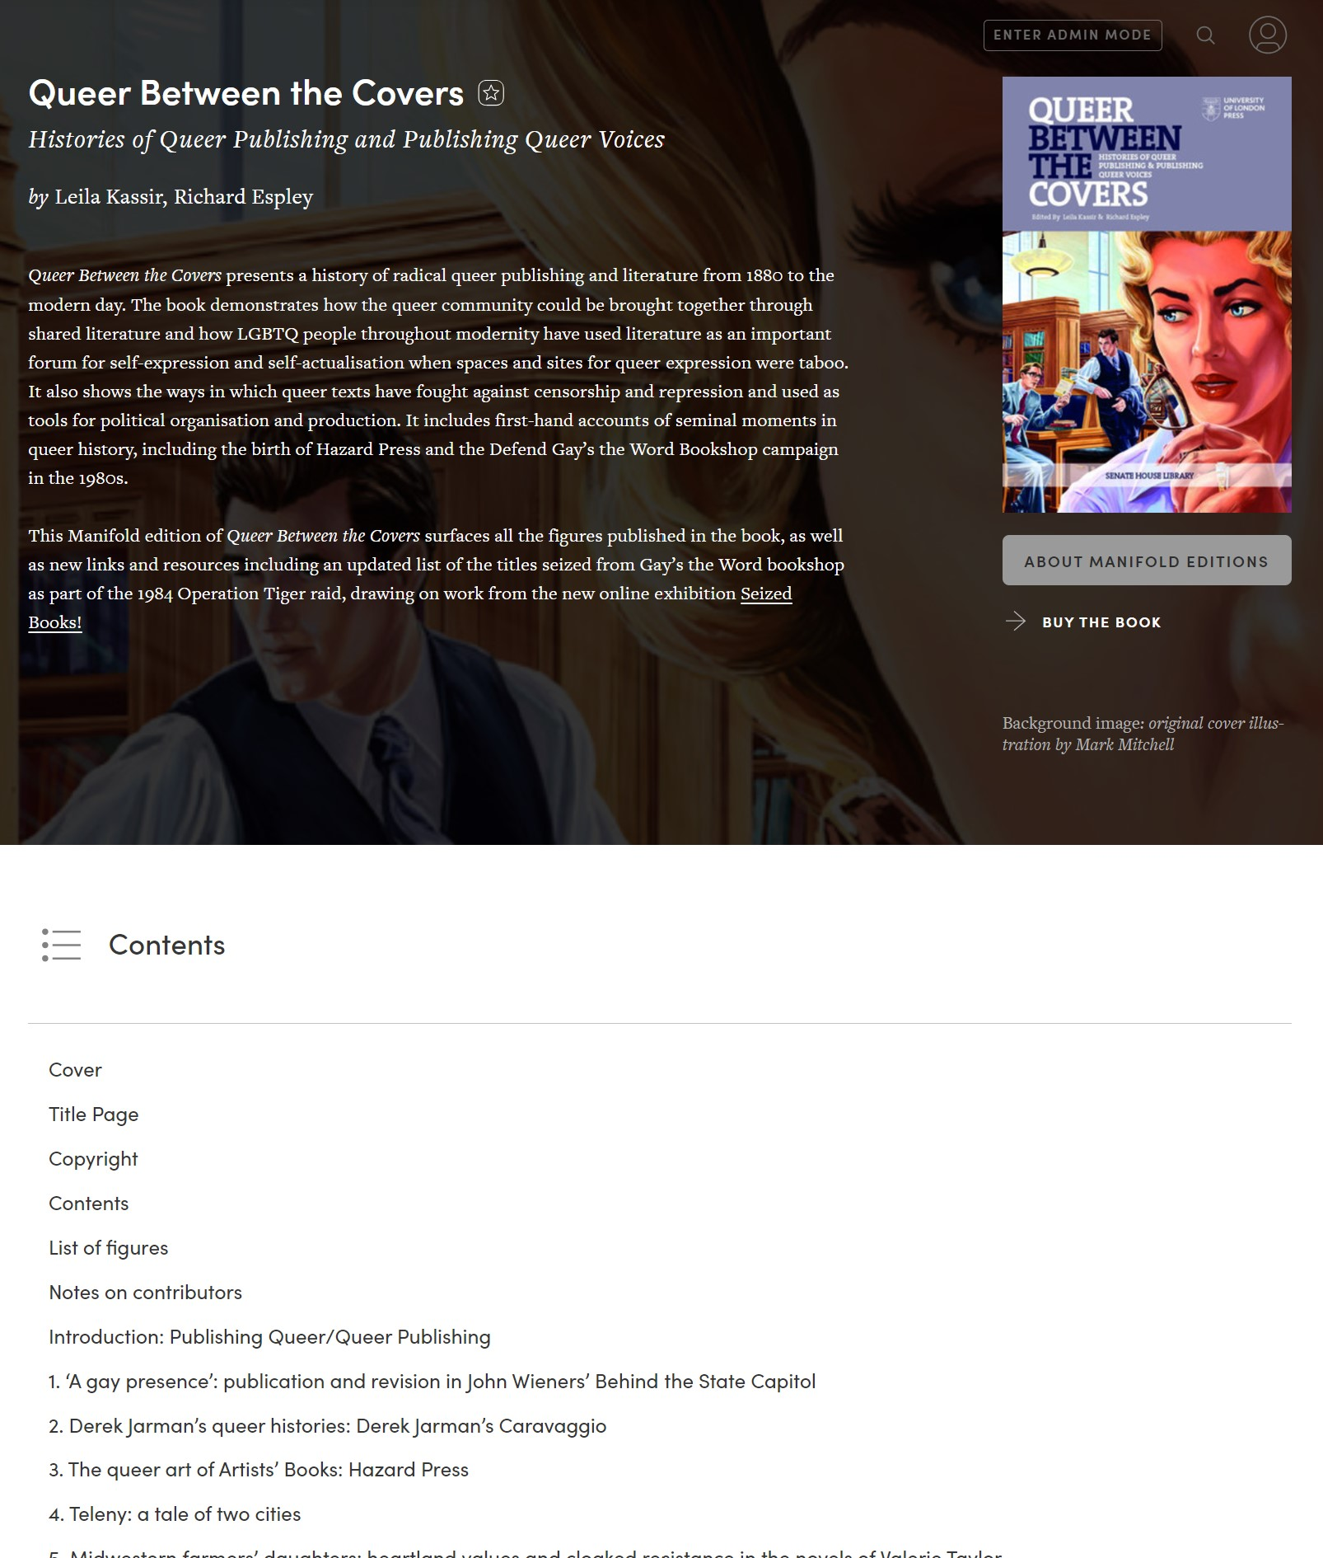
How we’re using Manifold
New open access editions (frontlist and backlist)
‘Reimagined’ editions
Experiments in open access:
  Multimedia and interactive content
  Open peer review
  Iterative publishing
  Experiments with book form, workflow and collaboration

Slide 4
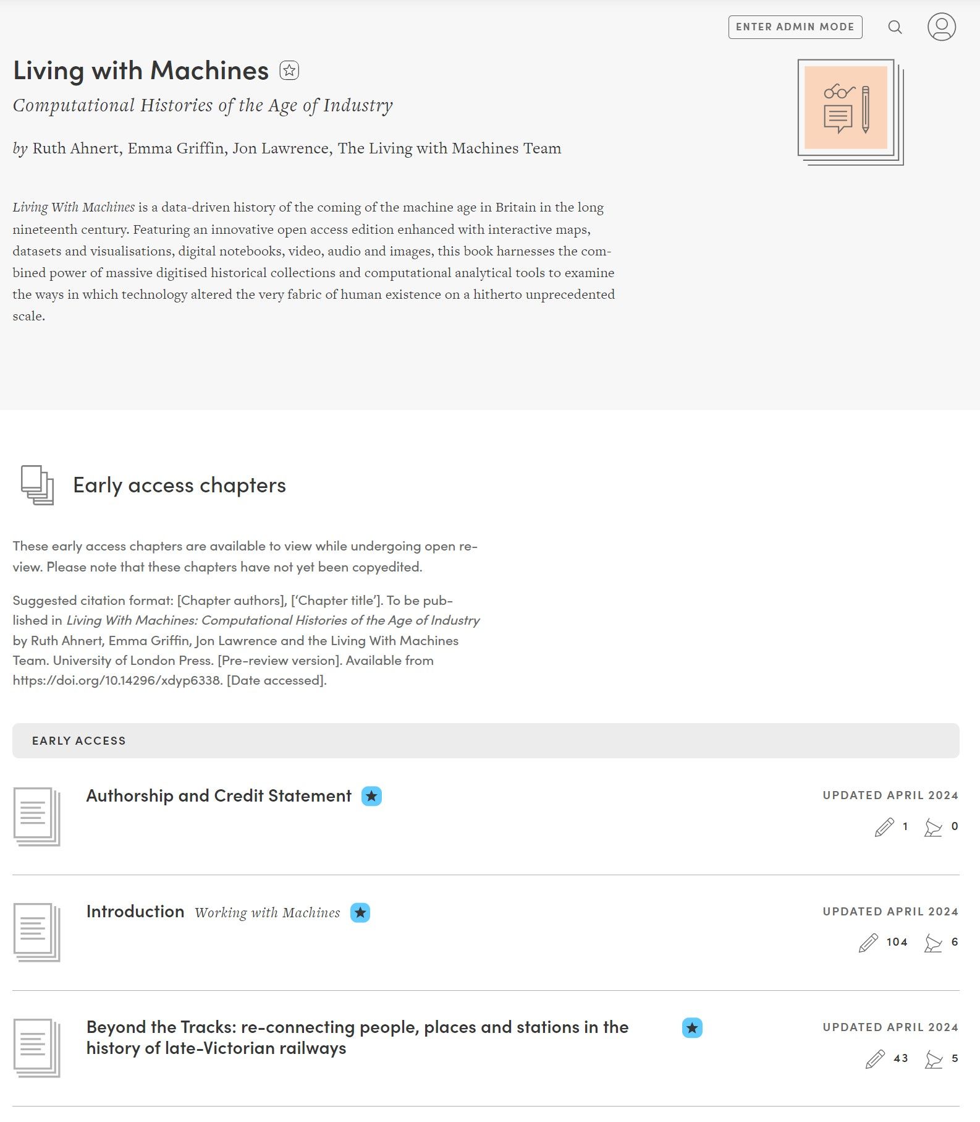
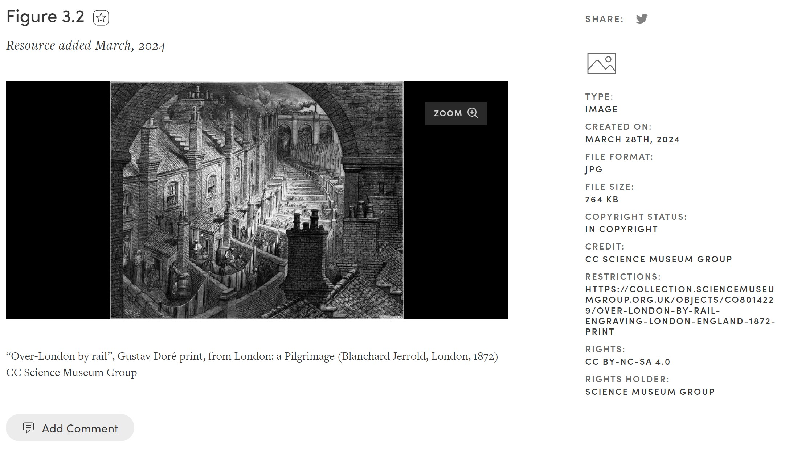
Example:
Living with Machines
(Edited by Ruth Ahnert, Emma Griffin and Jon Lawrence. Written by The Living with Machines Team)

Slide 5
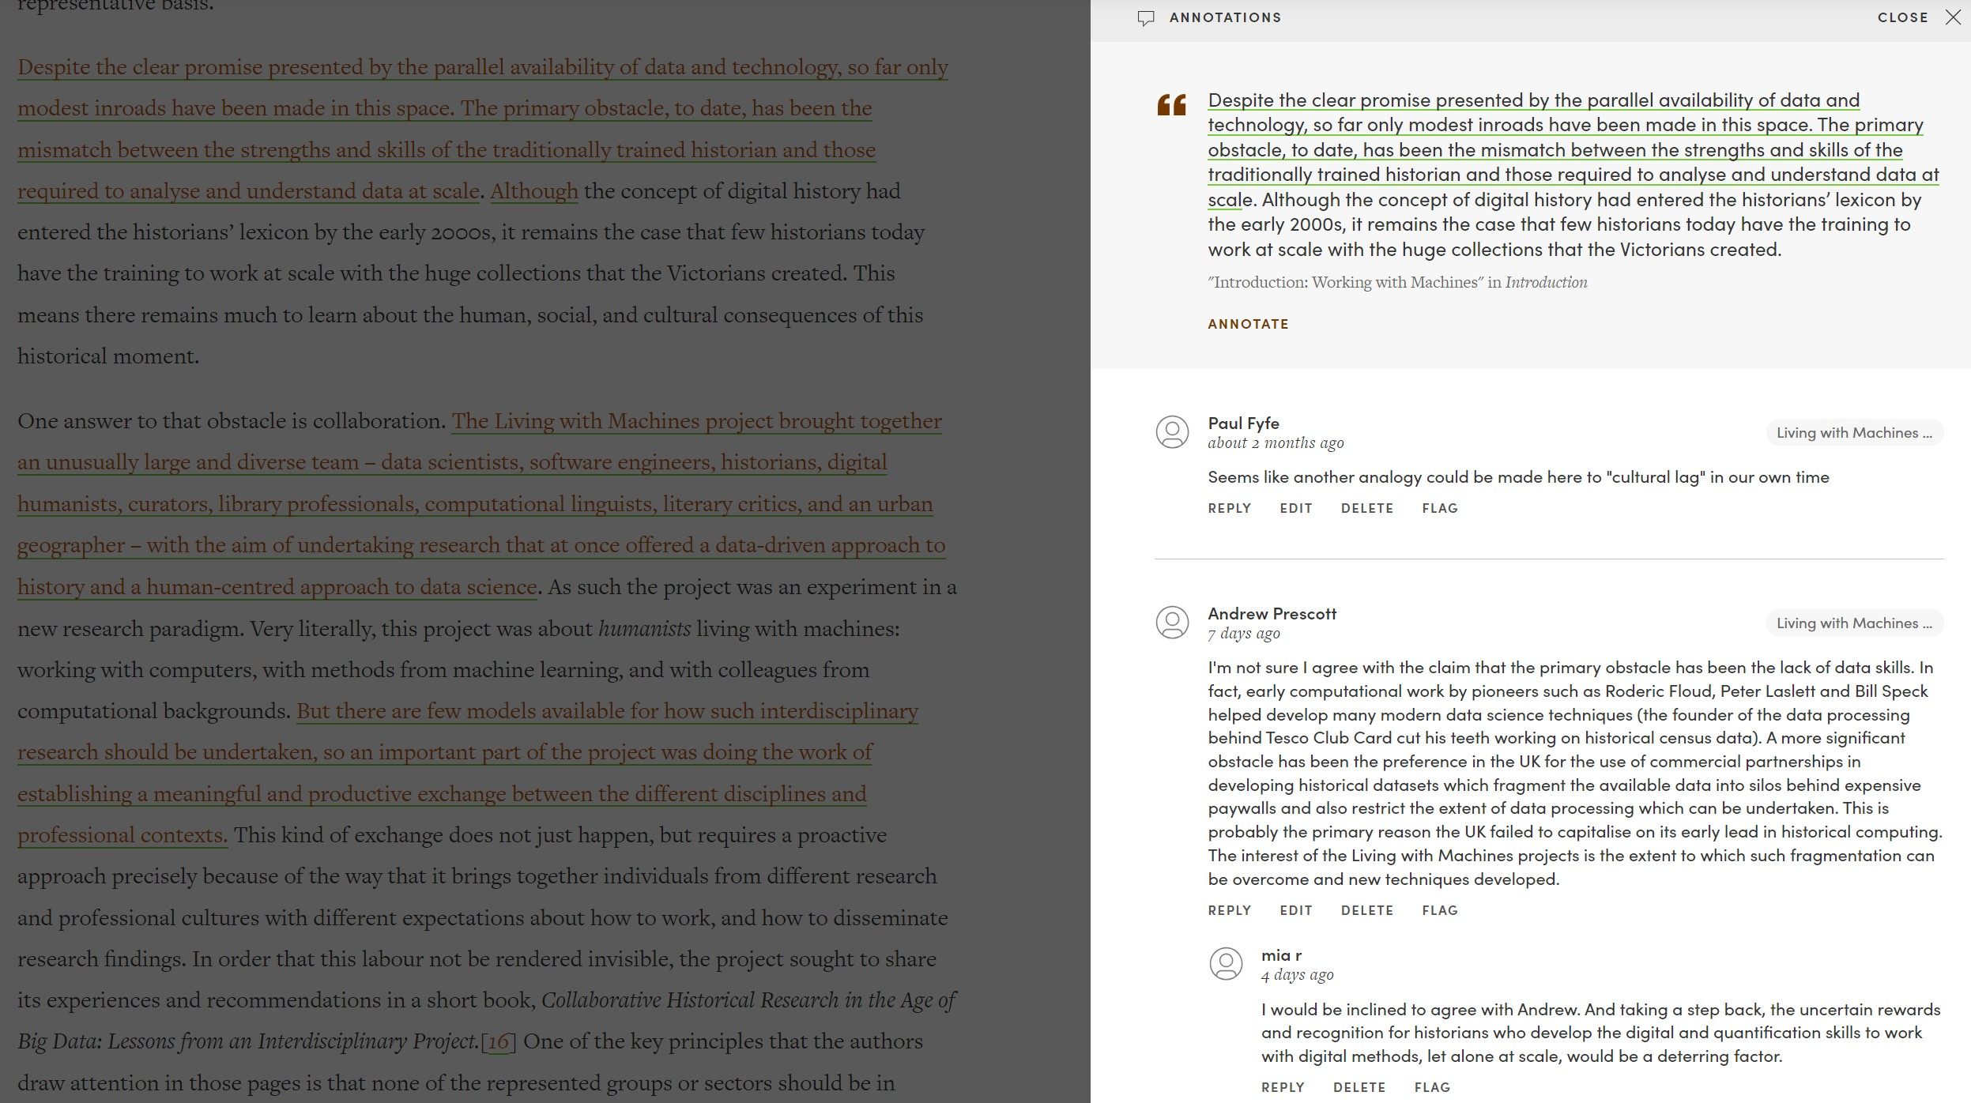

Slide 6
Open review: reflections
Opportunity for dialogue between peer reviewers and authors
New editorial and production ways of working
Need to build in additional time for complex Manifold elements – lots of back and forth
Reviewer engagement

Slide 7

Thank you
Emma Gallon, Publisher
Emma.Gallon@sas.ac.uk

