Slide 1
OERs and open textbooks
Next steps at the University of Sheffield
Anna Grigson
Associate Director (Library)
June 2024

Slide 2

Where we are now

Slide 3

Guidance for University staff
https://www.sheffield.ac.uk/library/
open-access/open-educational-resources

Slide 4

University policy on OER
https://www.sheffield.ac.uk/govern/
documents#Doc

Slide 5

White Rose Libraries OER toolkit
https://sites.google.com/york.ac.uk/
oertoolkit/home

Slide 6

OER working group
https://sites.google.com/
sheffield.ac.uk/oer-working-group/home

Slide 7

University of Sheffield Pressbooks Network
https://sheffield.pressbooks.pub/

Slide 8
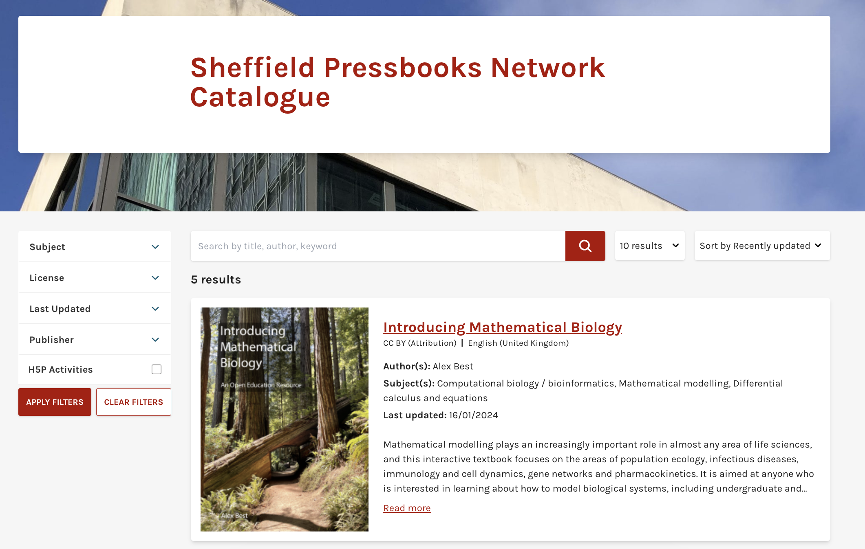
OERs published
https://sheffield.pressbooks.pub/
catalogue/

Slide 9
Next steps
Scale our OER service
  Funding
  Infrastructure
  Workflows
Continuing to develop our OA publishing through White Rose University Press
Develop our wider approach to affordable learning resources
  Assessing the scale of the etextbook ‘affordability gap’ for our courses
  Developing a strategy to address the gap, and gaining senior buy-in
  Undertaking a pilot project to model ‘affordable resources’ for a specific module

