Slide 1





Dare to boast: In defence of book marketing and celebrating wins
Tuesday 21st October 2025
Elinor Potts, LSE Press
press.lse.ac.uk
@LSEPress
LSE Press

Slide 2

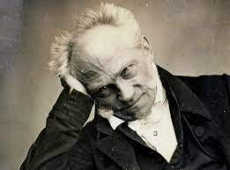
Dare to boast: In defence of book marketing and celebrating wins
LSE Press
Notes:
They say that

Slide 3

Dare to boast: In defence of book marketing and celebrating wins
LSE Press

Slide 4
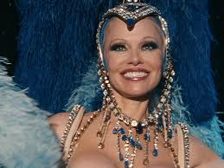
Dare to boast: In defence of book marketing and celebrating wins
press.lse.ac.uk
@LSEPress
LSE Press

Slide 5
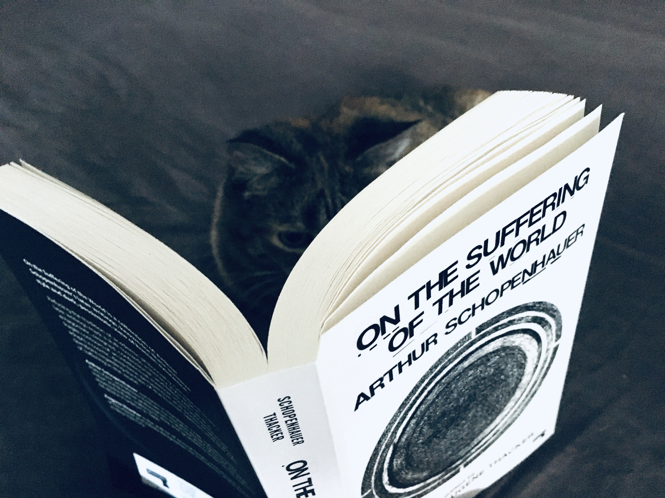
Dare to boast: In defence of book marketing and celebrating wins
press.lse.ac.uk
@LSEPress
LSE Press

Slide 6

Dare to boast: In defence of book marketing and celebrating wins
Celebrate
Align
Amplify
press.lse.ac.uk
@LSEPress
LSE Press

Slide 7

Dare to boast: In defence of book marketing and celebrating wins
press.lse.ac.uk
@LSEPress
LSE Press

Slide 8






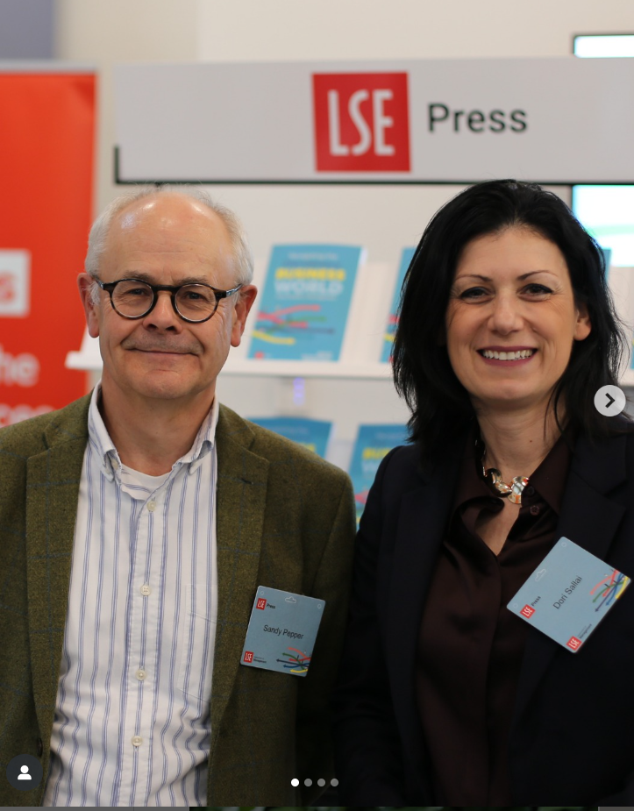

Dare to boast: In defence of book marketing and celebrating wins
press.lse.ac.uk
@LSEPress
LSE Press

Slide 9
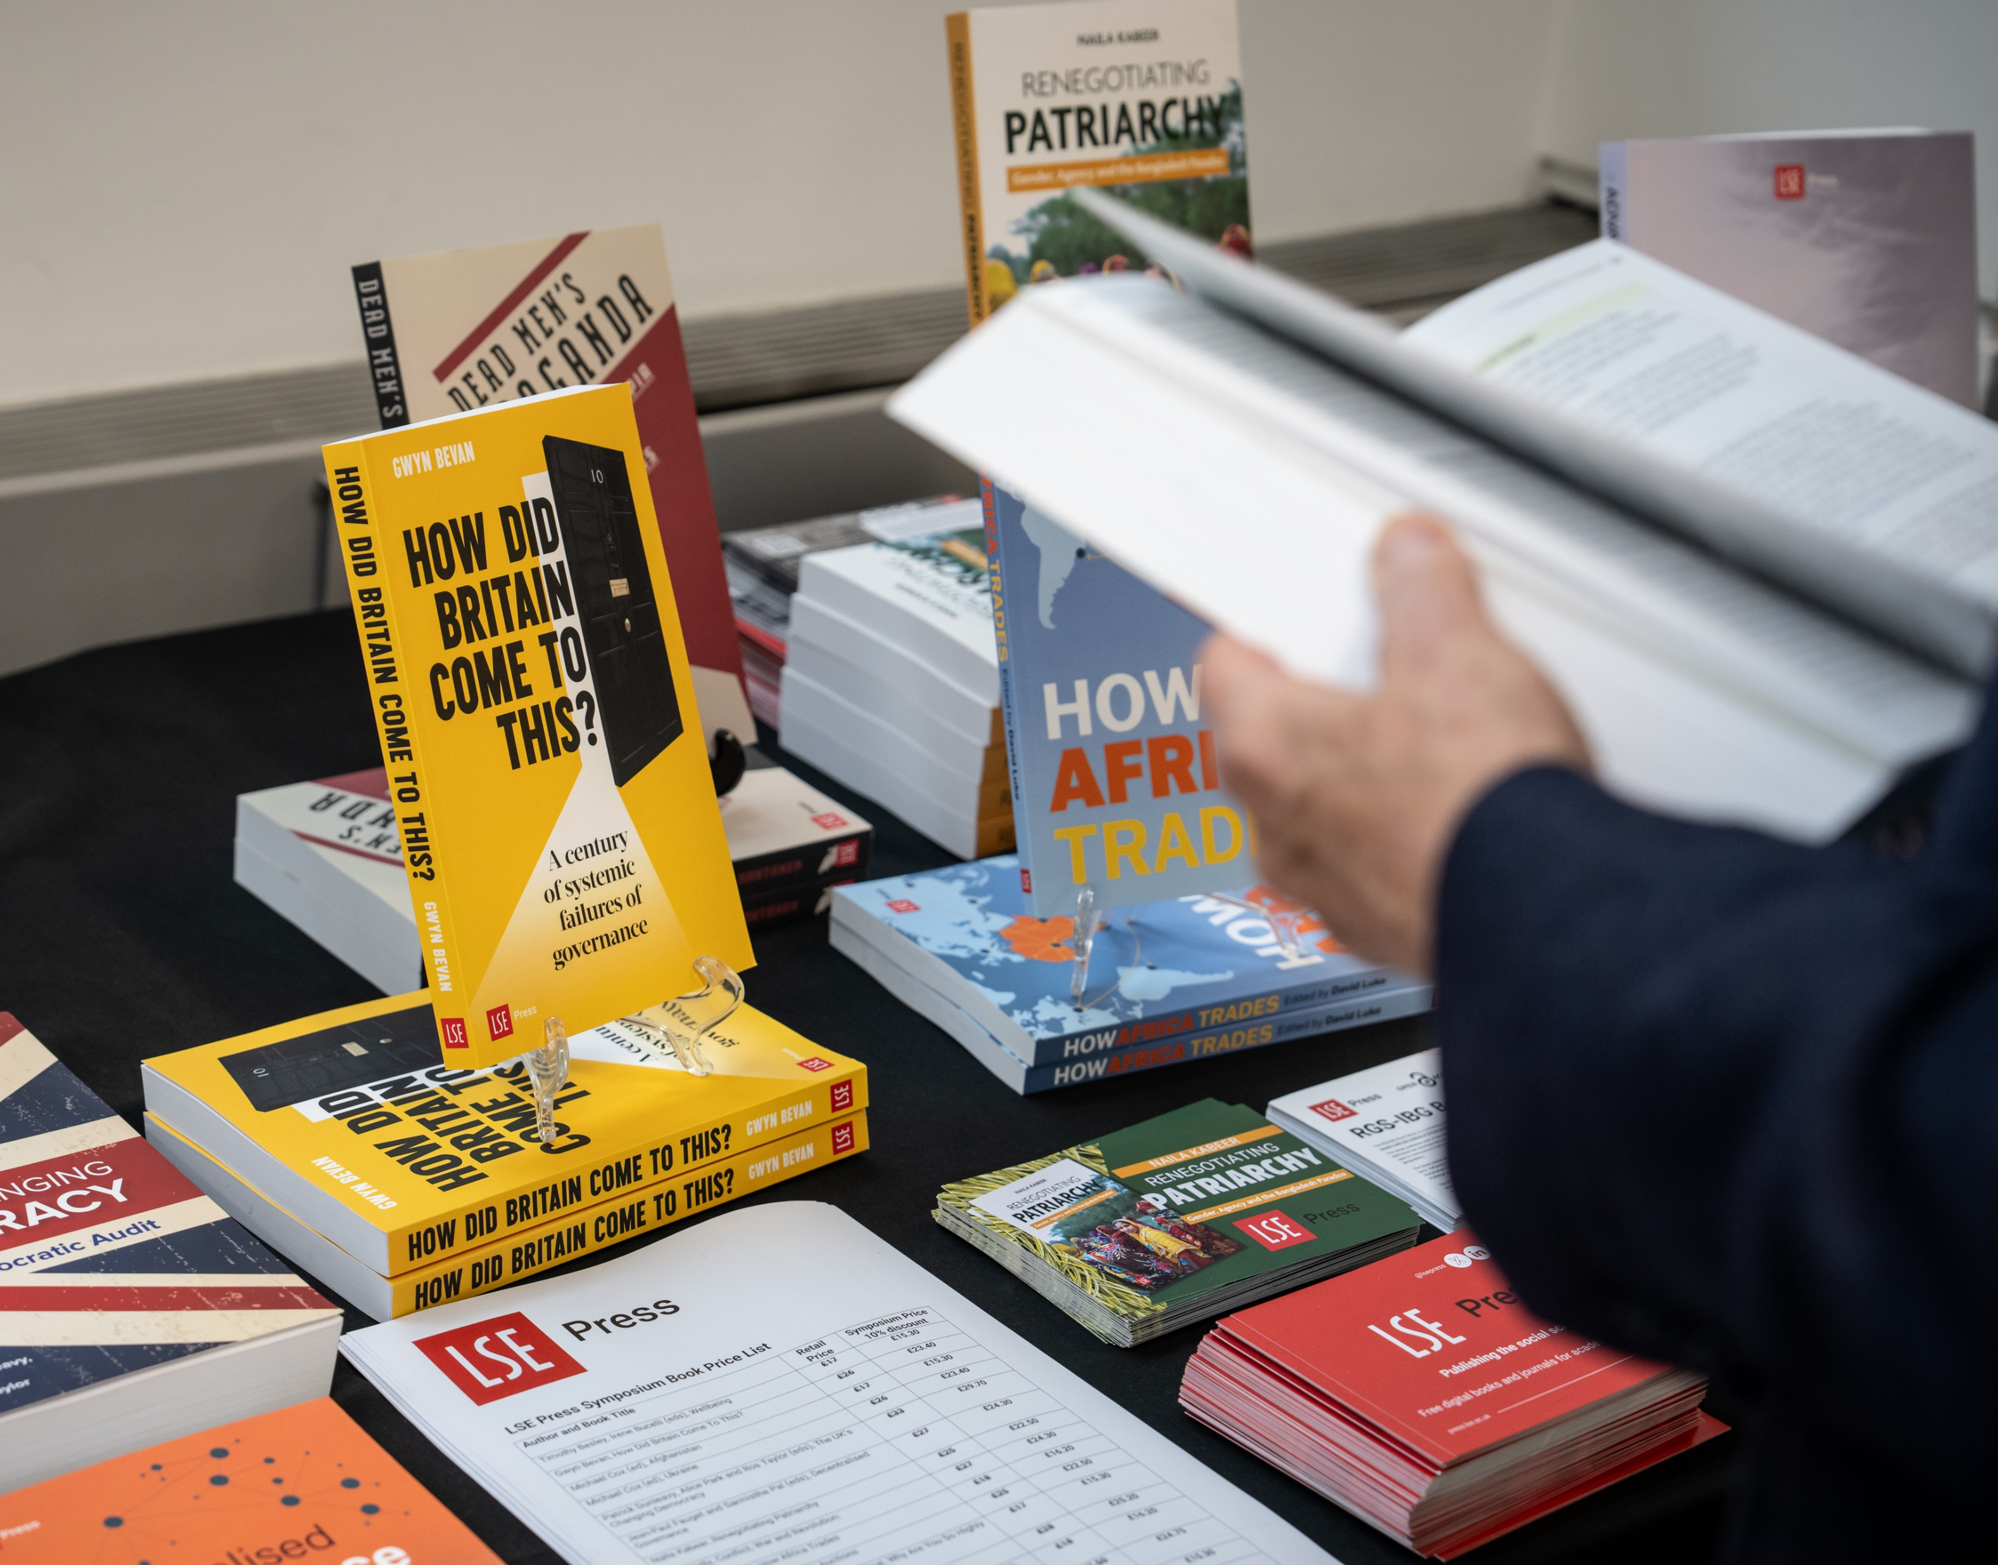



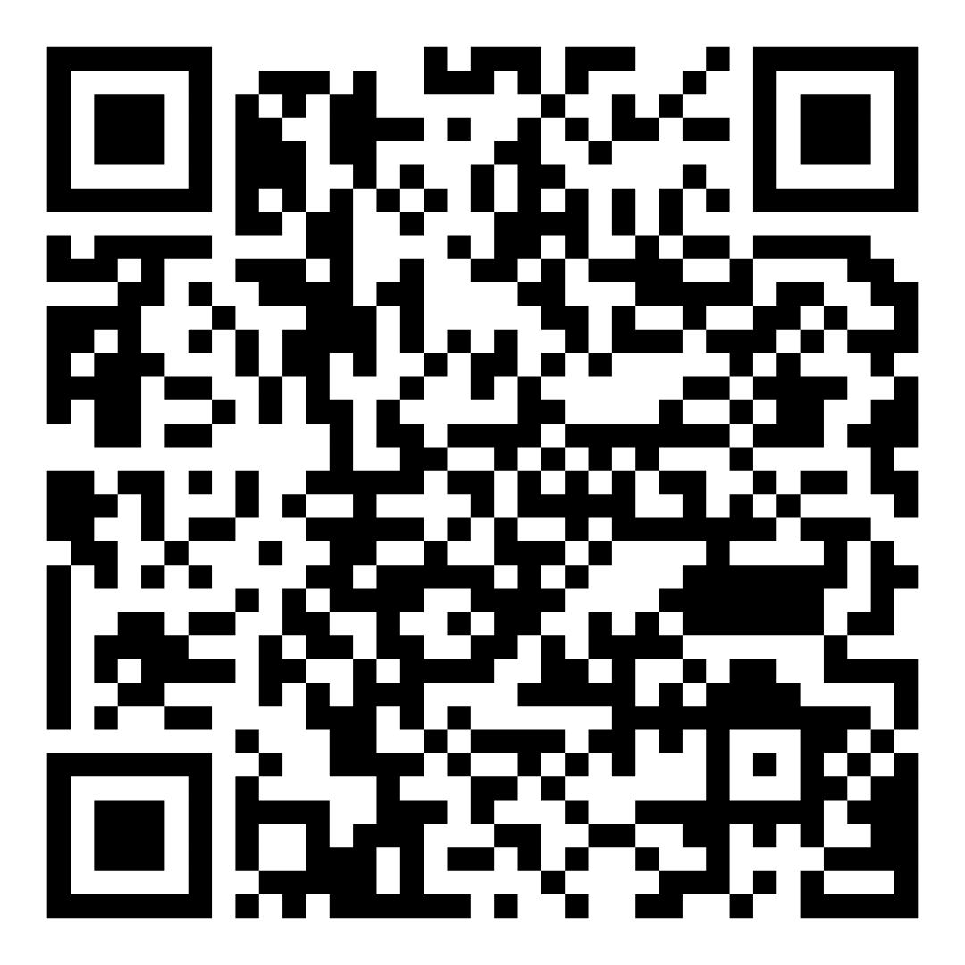
Keep in touch
www.press.lse.ac.uk
LSE Press
@lsepress.bsky.social
e.potts@lse.ac.uk
Sign up to the LSE Press newsletter here

