Slide 1
Brown University Digital Publications:
NEW APPROACHES TO COLLABORATION
OIPA Symposium
Allison Levy, Brown University Digital Publications
Allison_Levy@Brown.edu
October 21, 2025

Slide 2

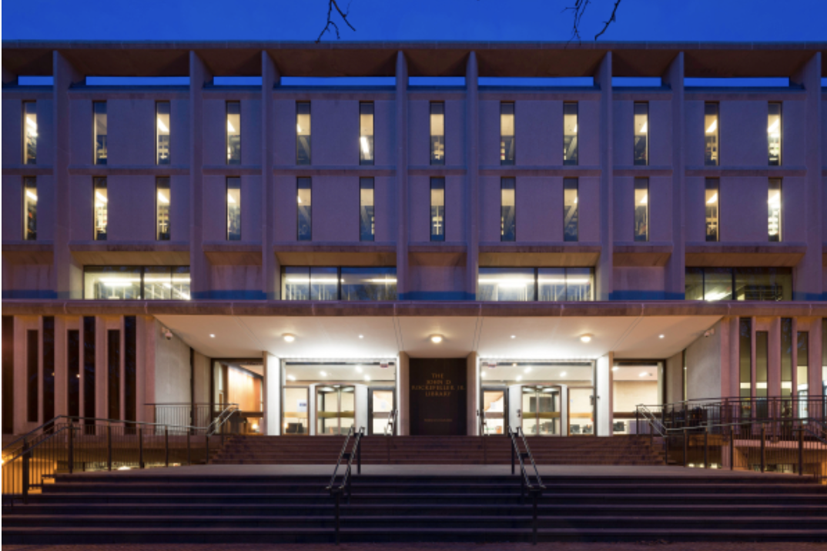






Slide 3
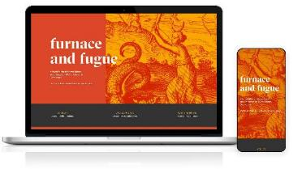



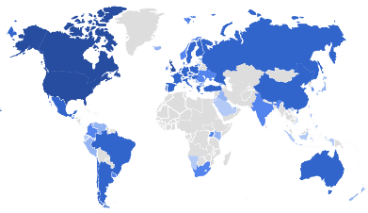


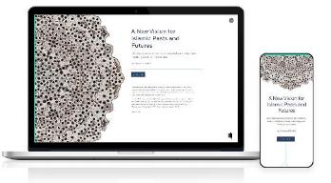



Slide 4
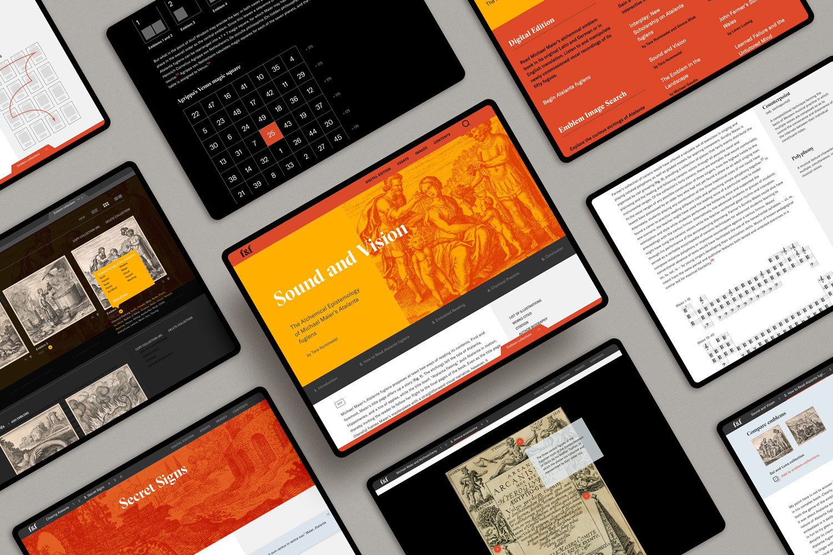
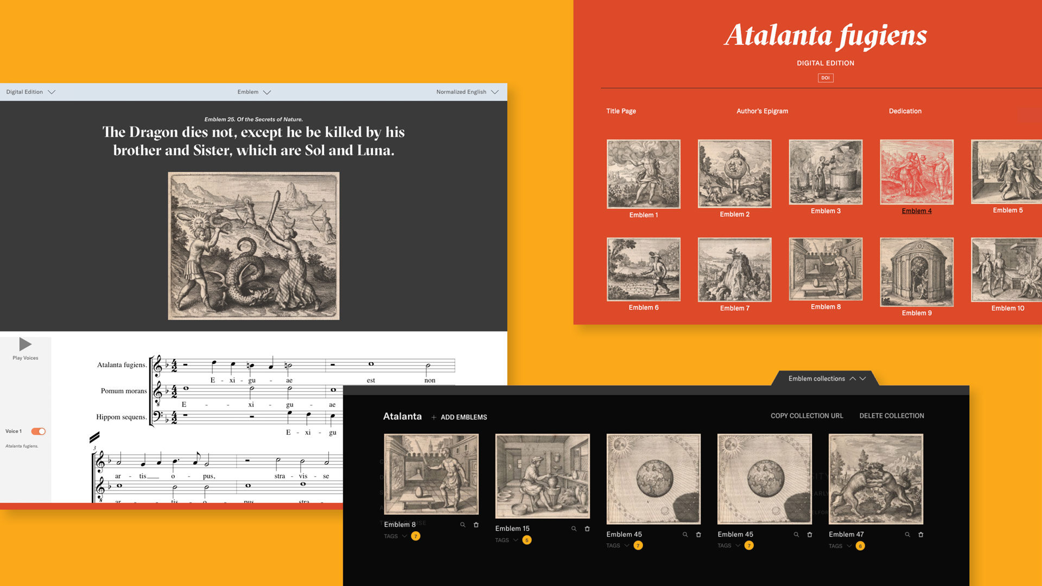
Furnace and Fugue: A Digital Edition of Michael Maier’s Atalanta fugiens (1618) with Scholarly Commentary, edited by Professor of History Tara Nummedal and Independent Scholar Donna Bilak
➢ University of Virginia Press, 2020
Studies in Early Modern German History book series
➢ Excerpt on Project MUSE
Winner of the 2022 Roy Rosenzweig Prize for Creativity in Digital History by the American Historical Association
Viewed by 32k unique users from 170 countries
Reviewed in
➢ RIDE: A Review Journal for Scholarly Digital
Editions and Resources
➢ Reviews in Digital Humanities
➢ Renaissance and Reformation / Renaissance et
R.forme
➢ Early Modern Digital Review

Slide 5
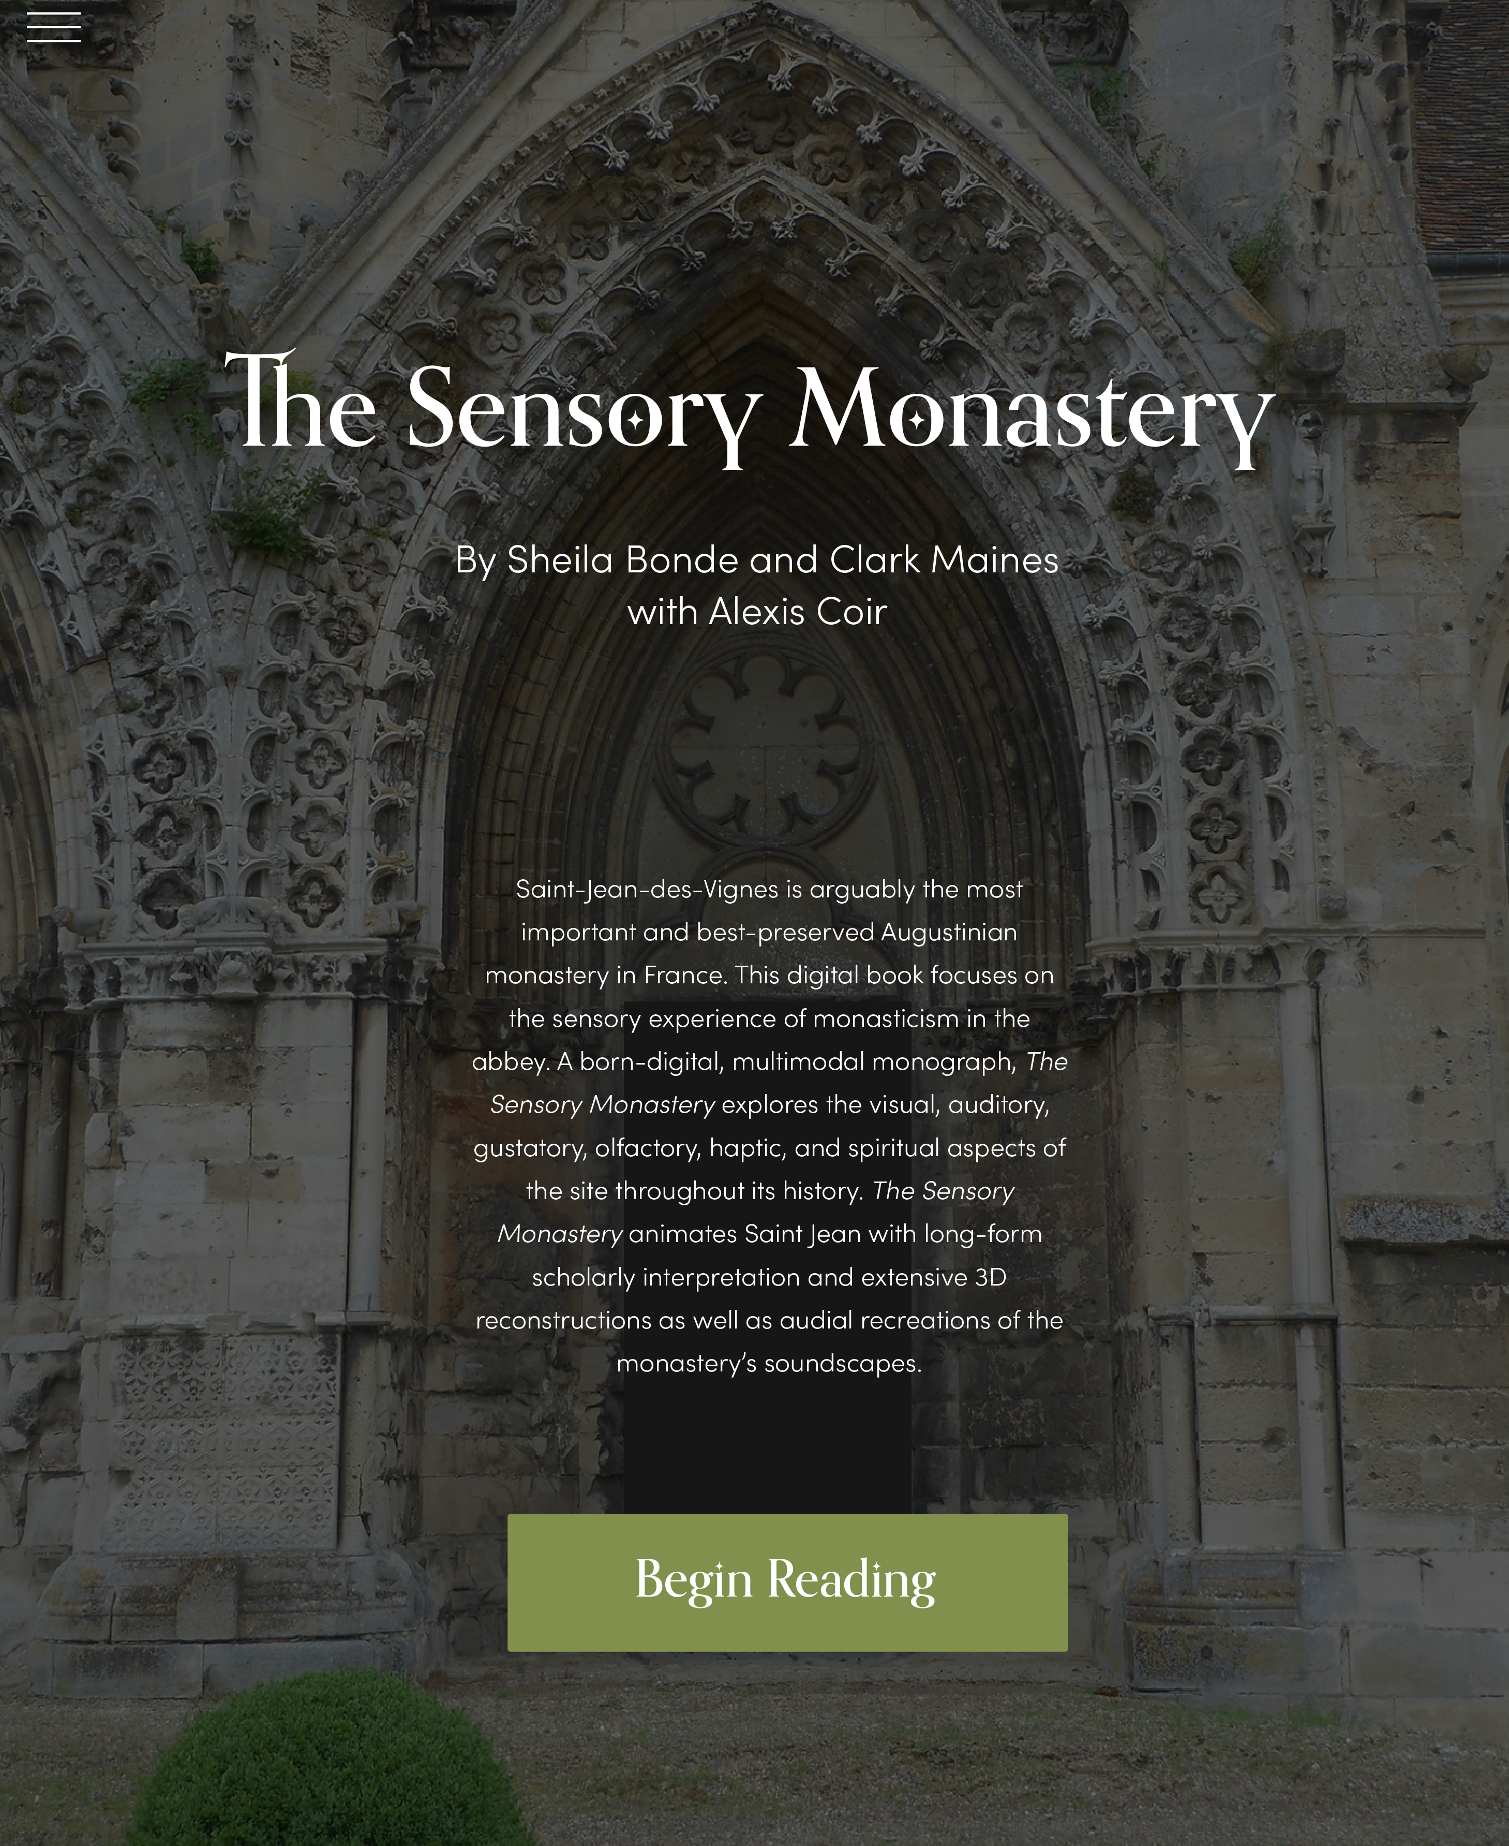
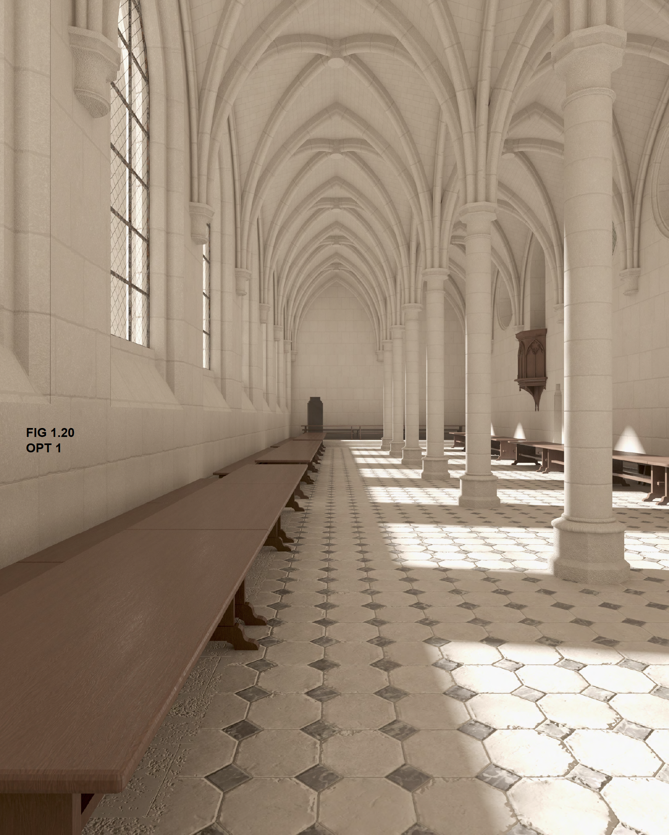
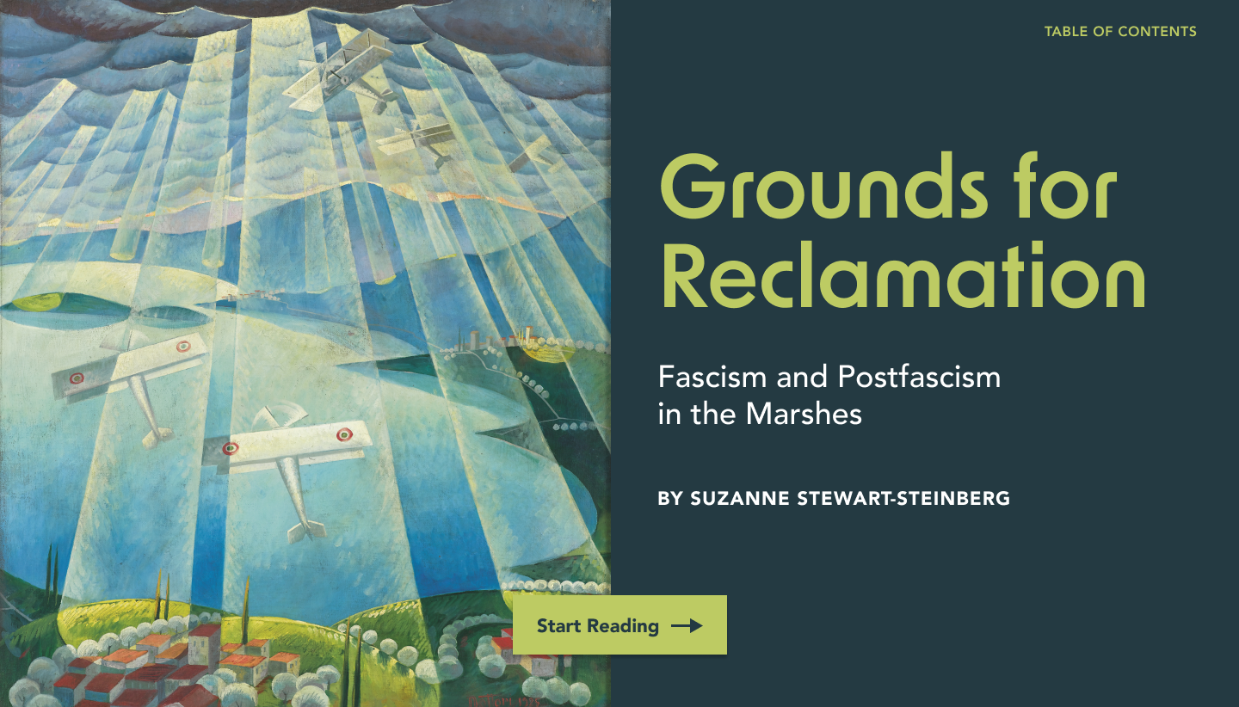
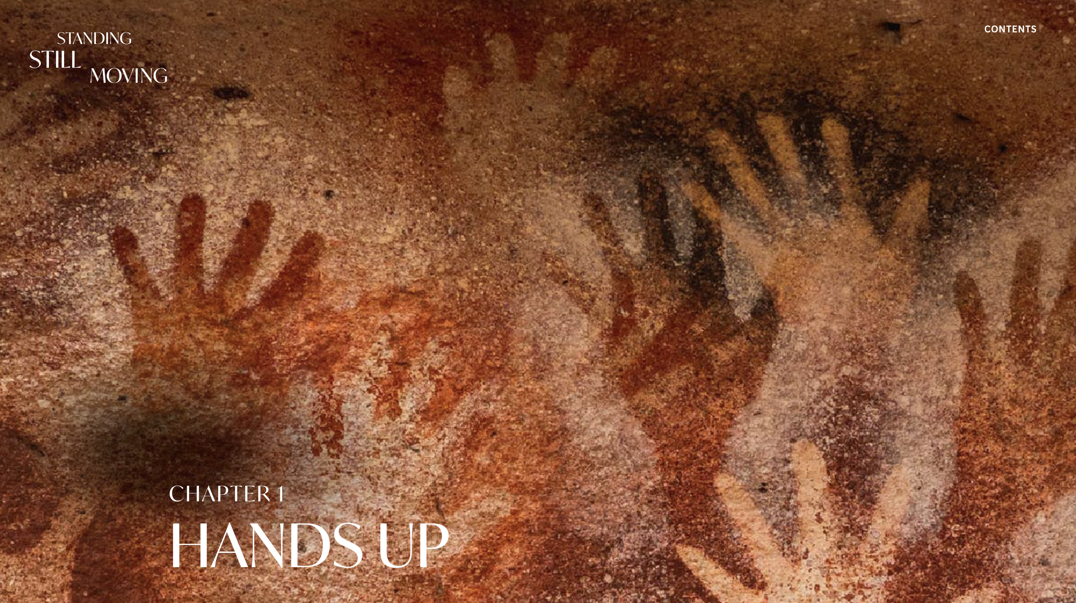
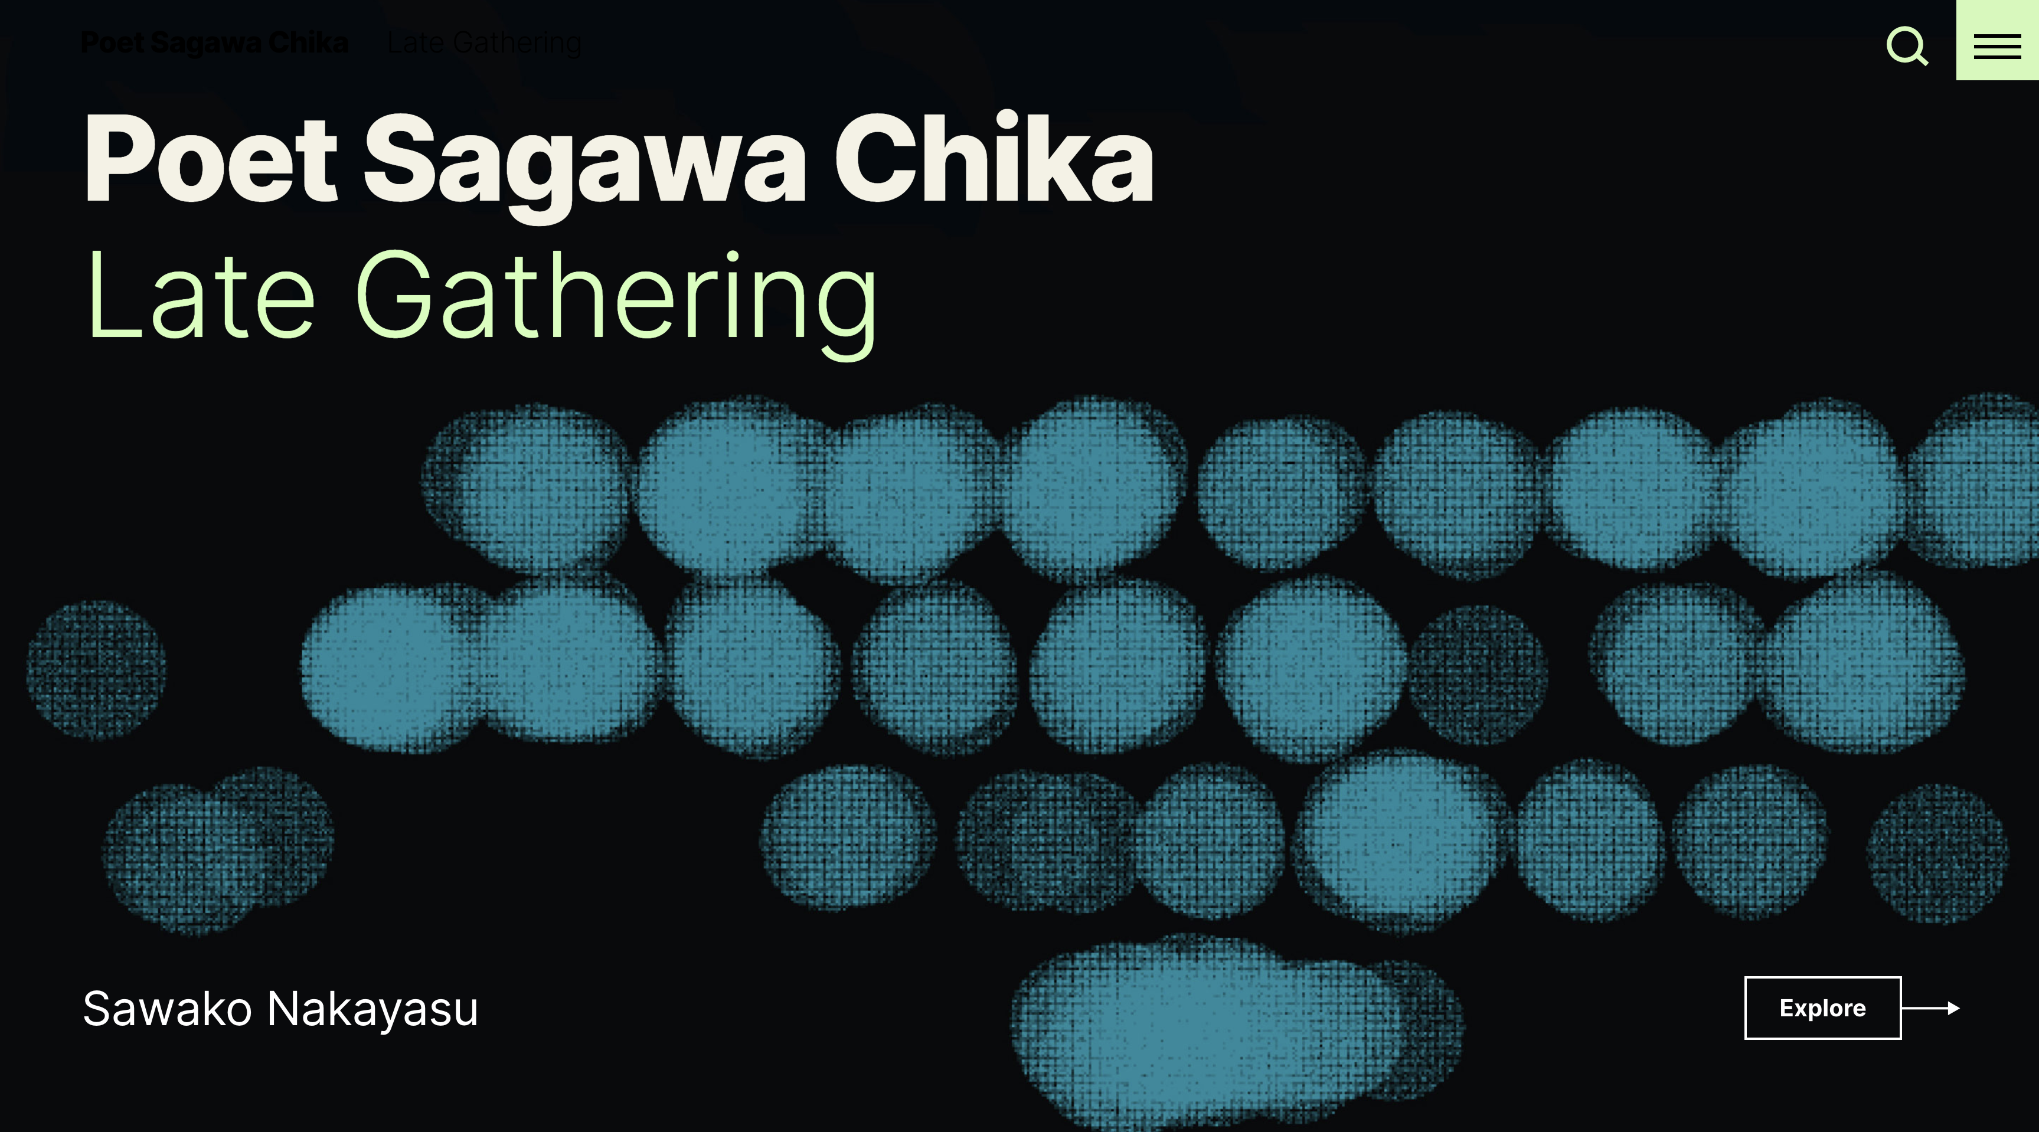

Slide 6
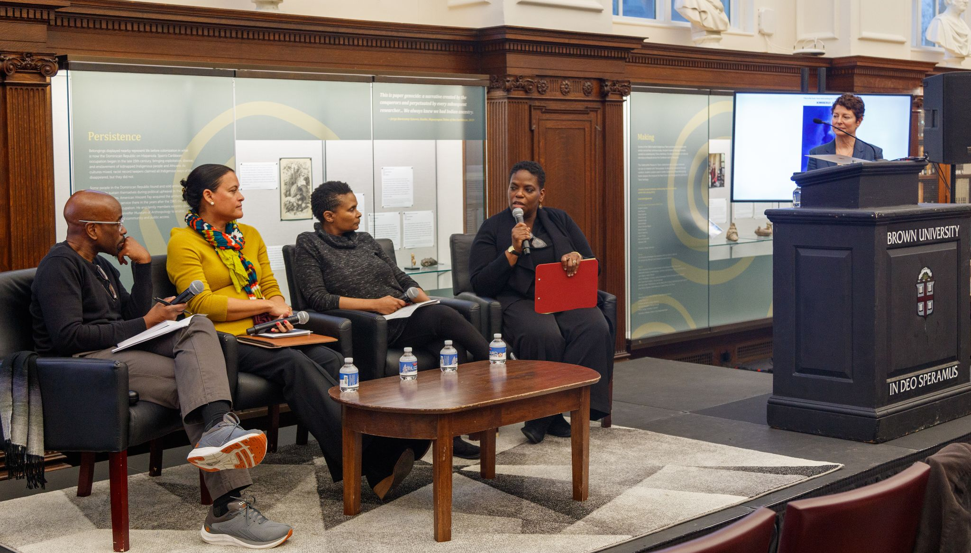
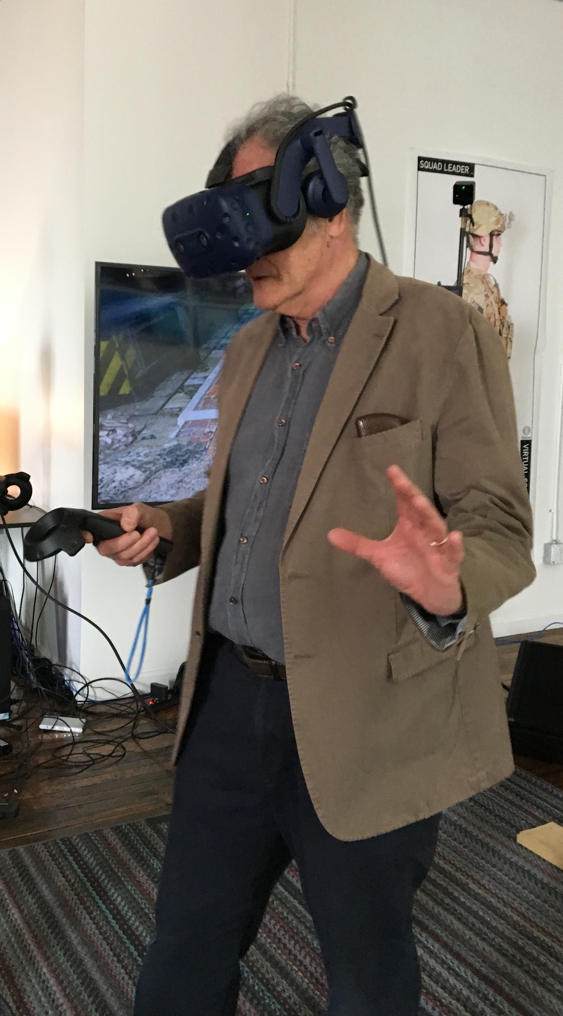
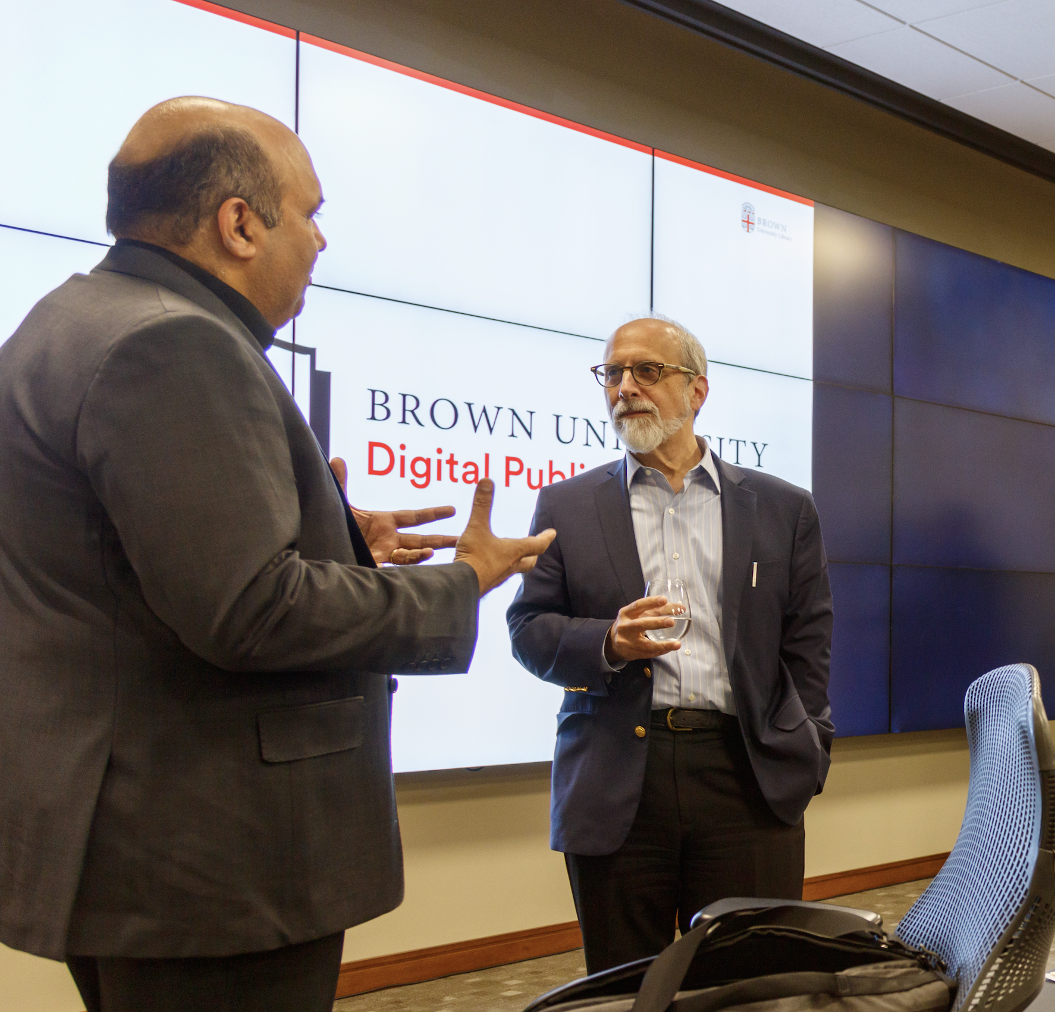
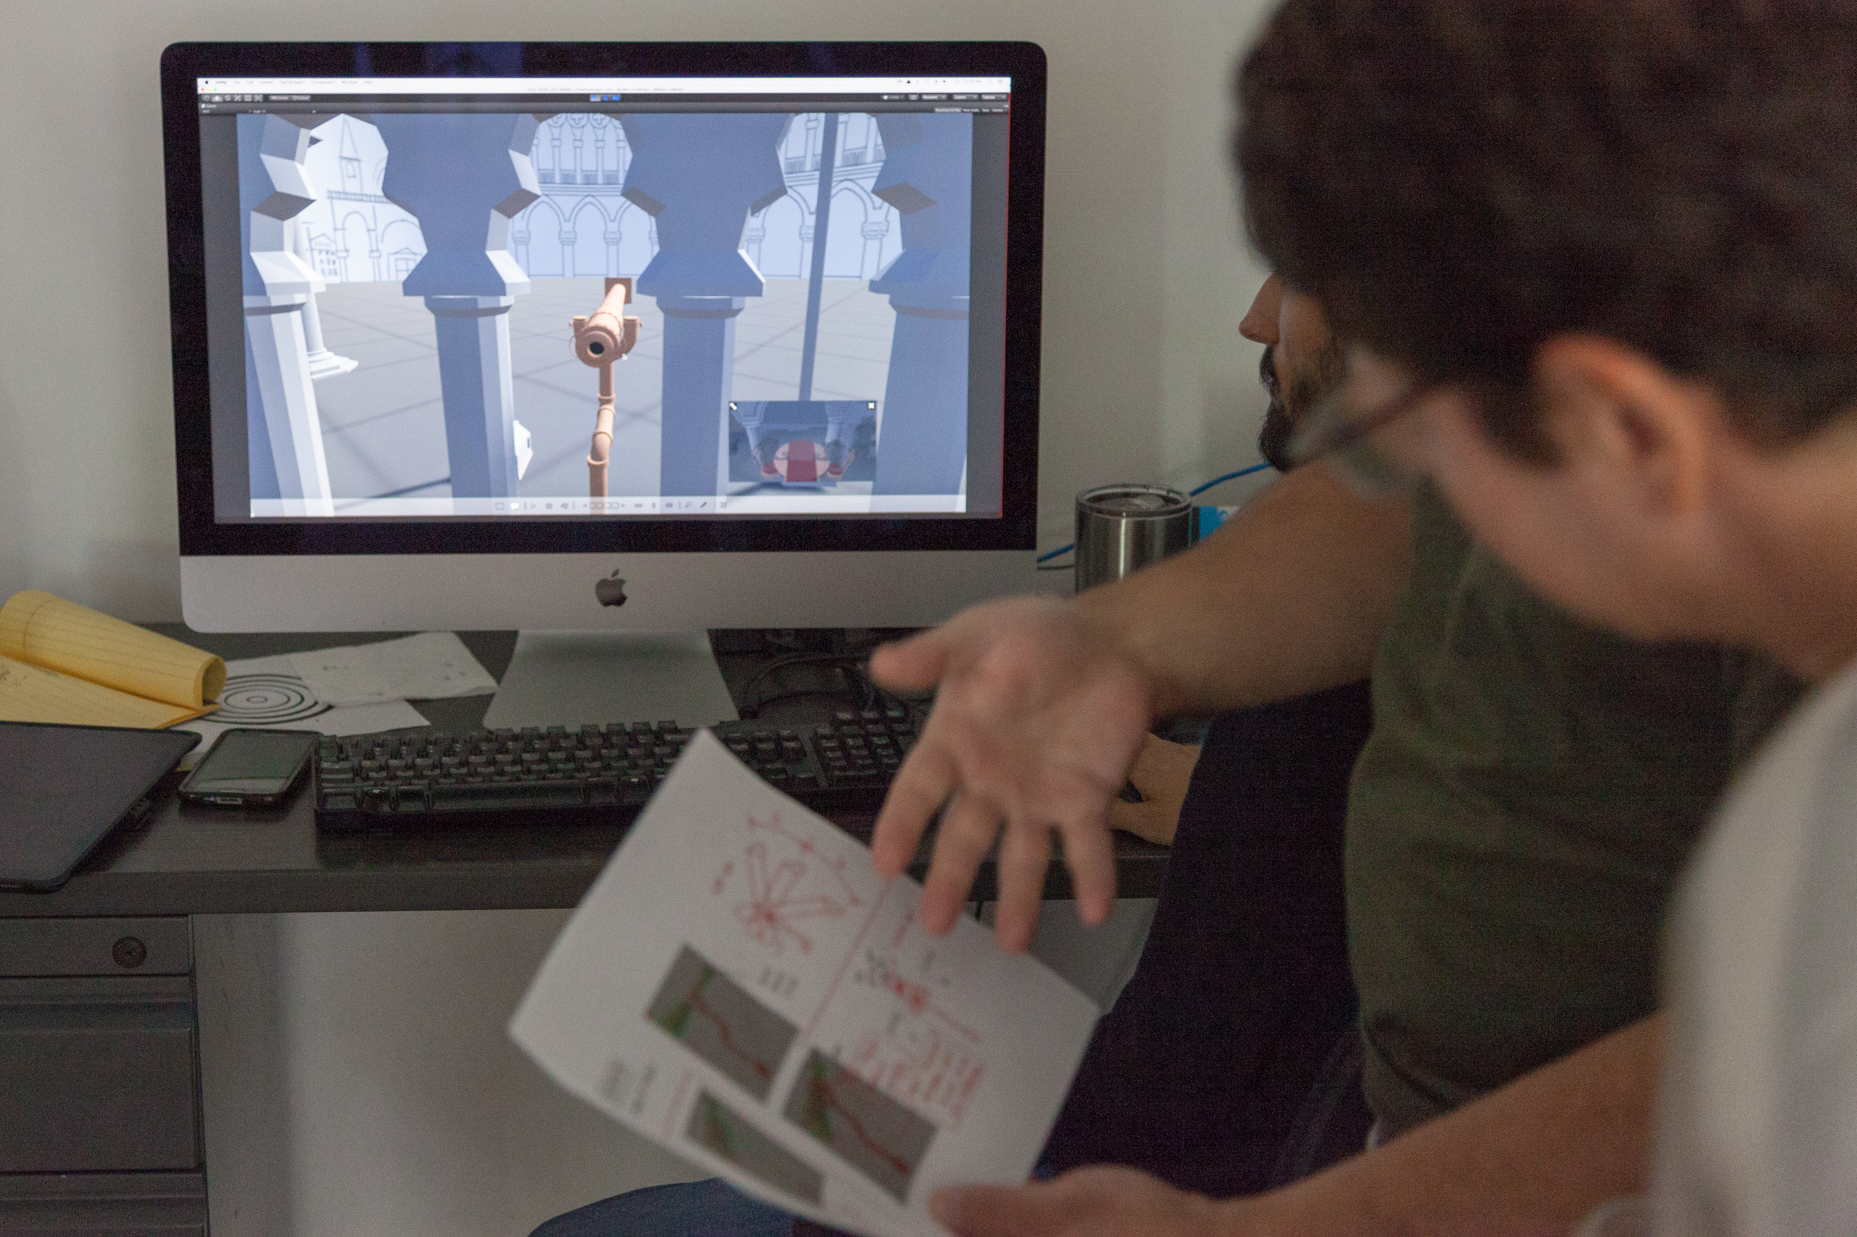
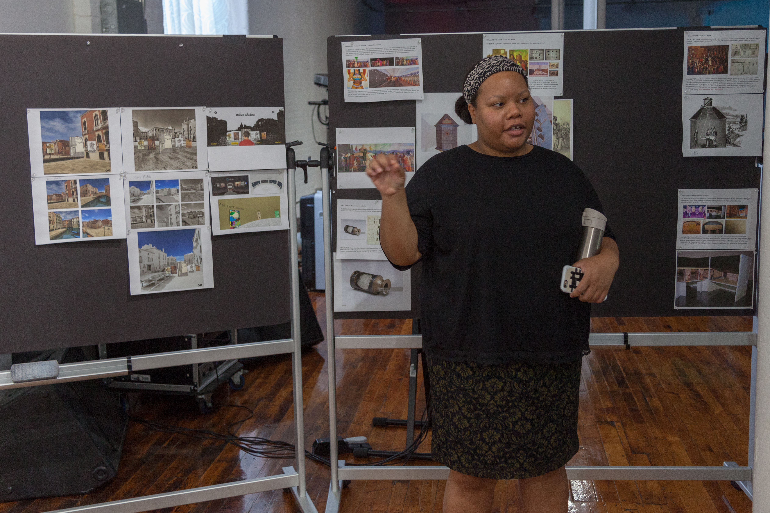

Slide 7
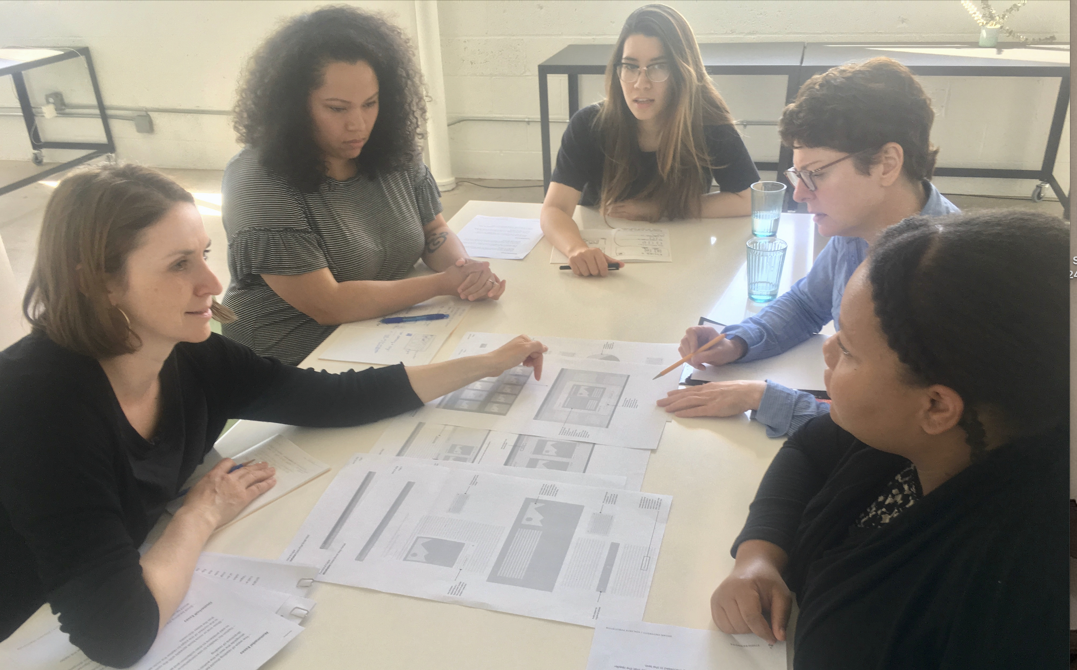
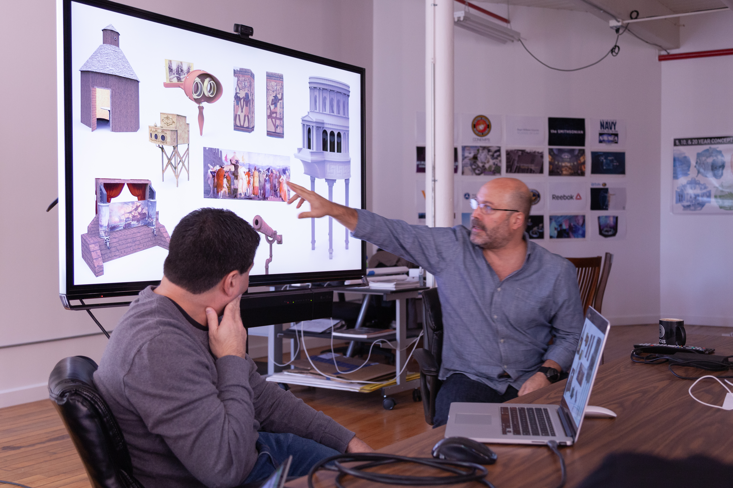
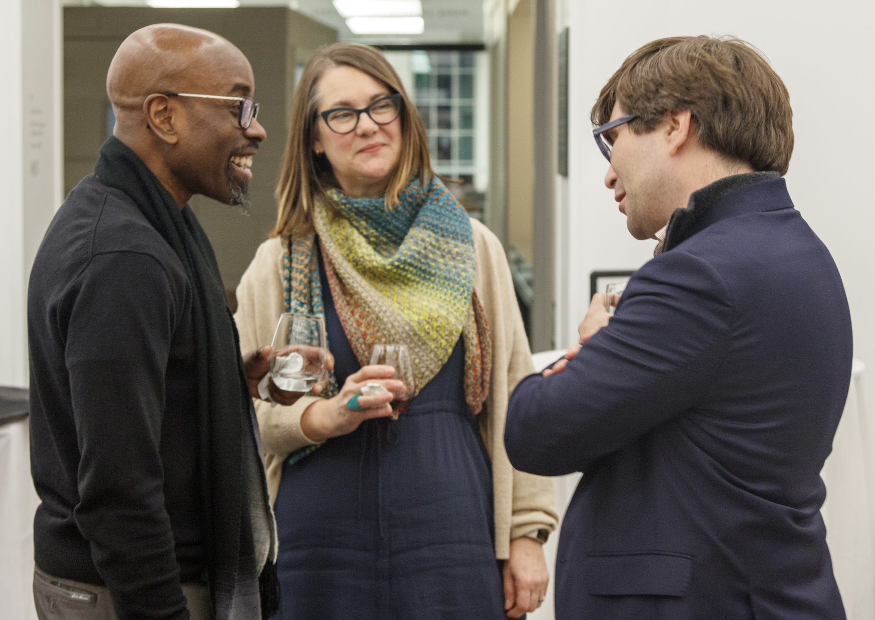
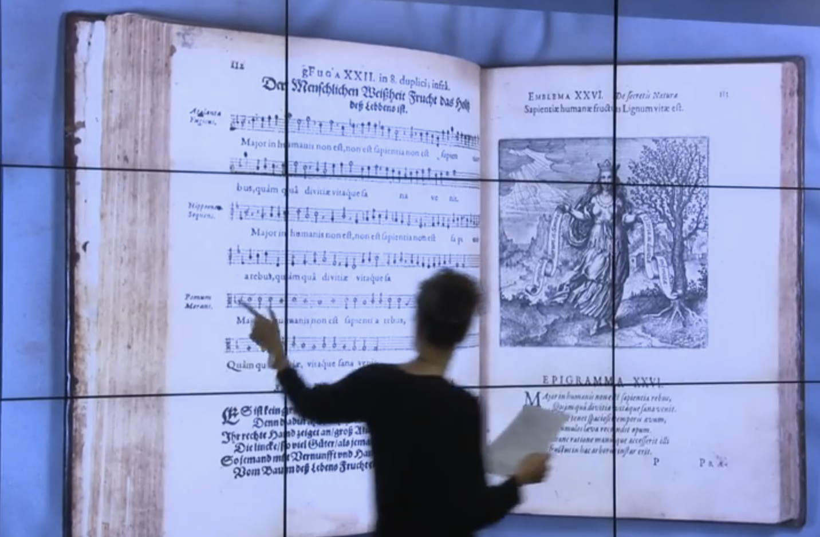
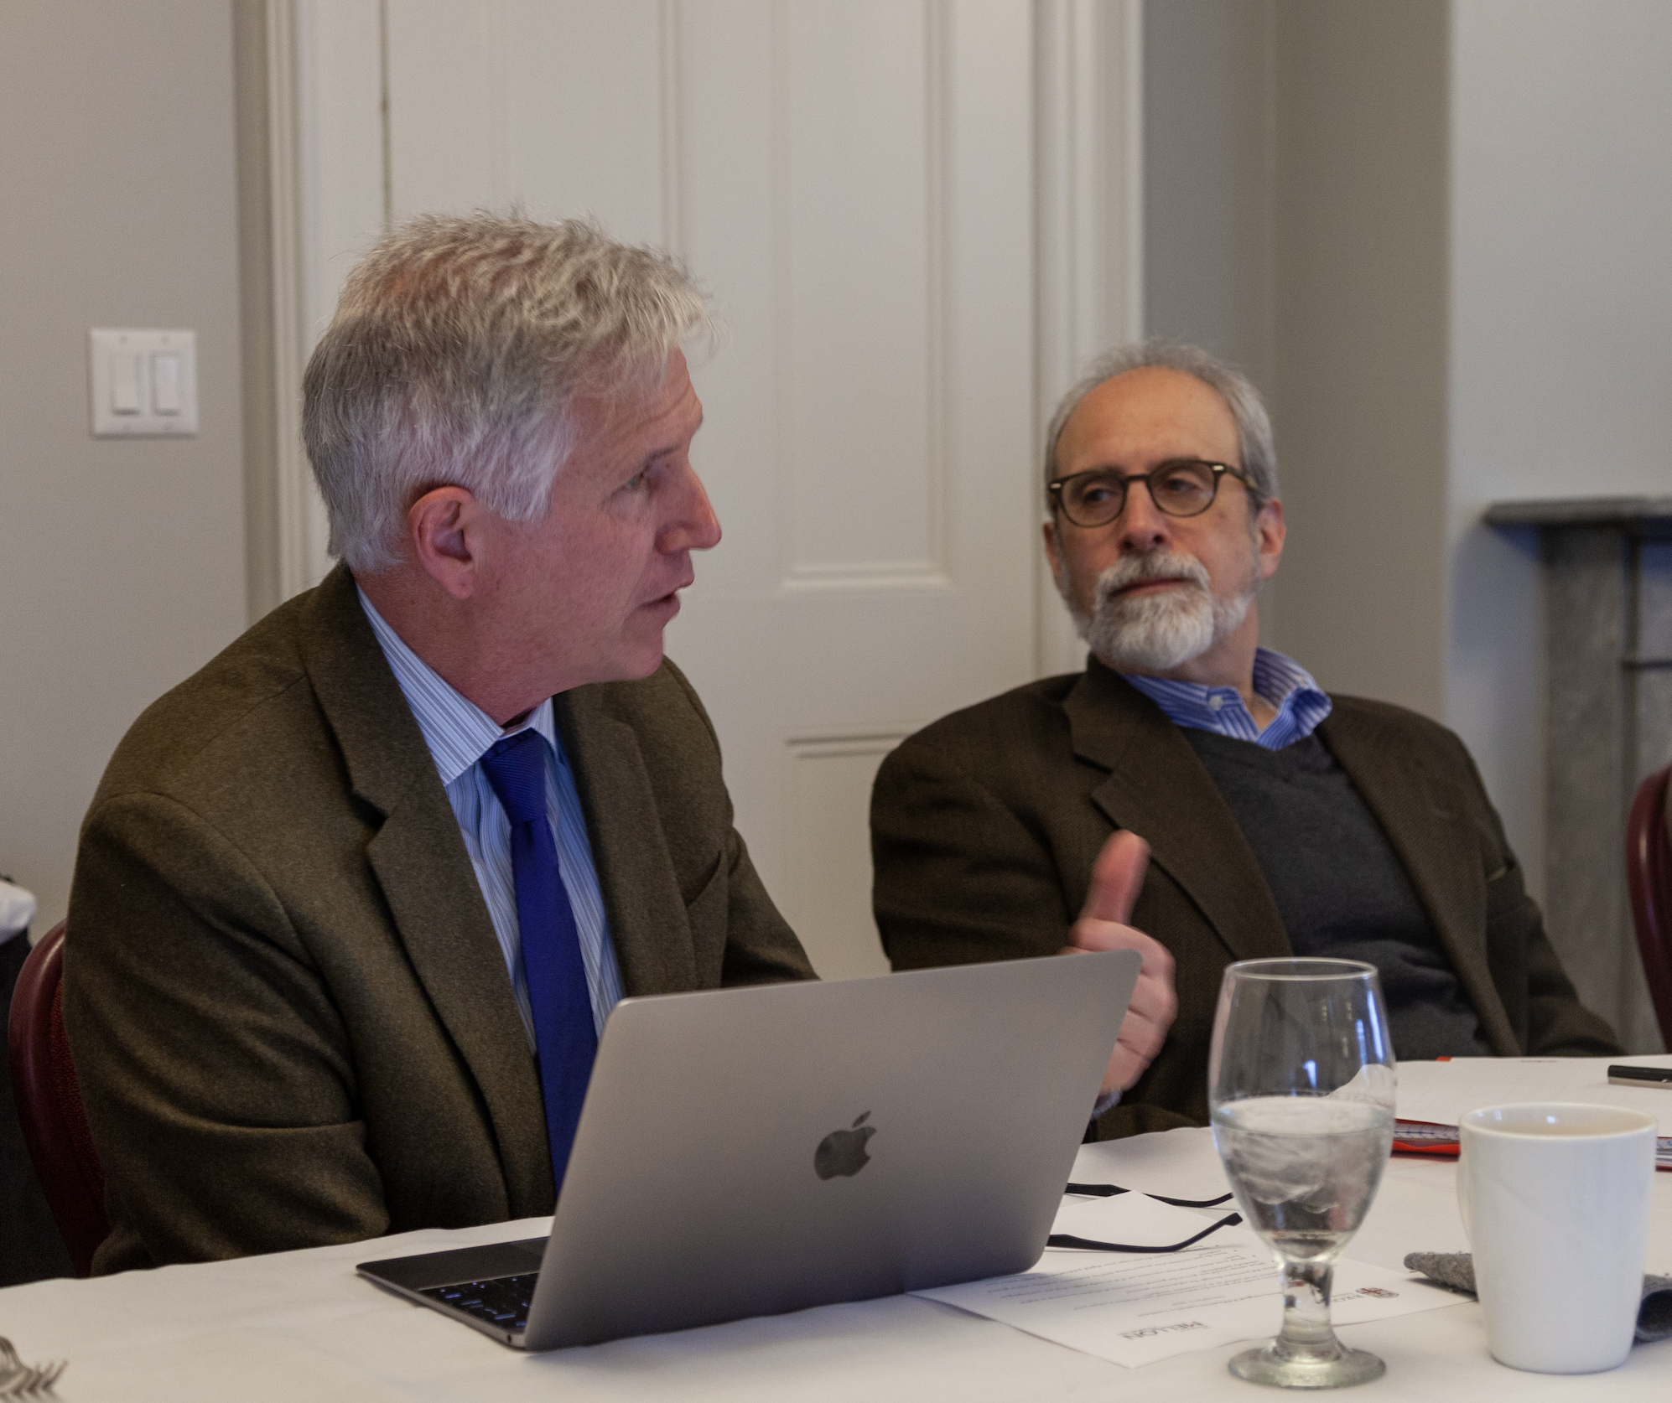
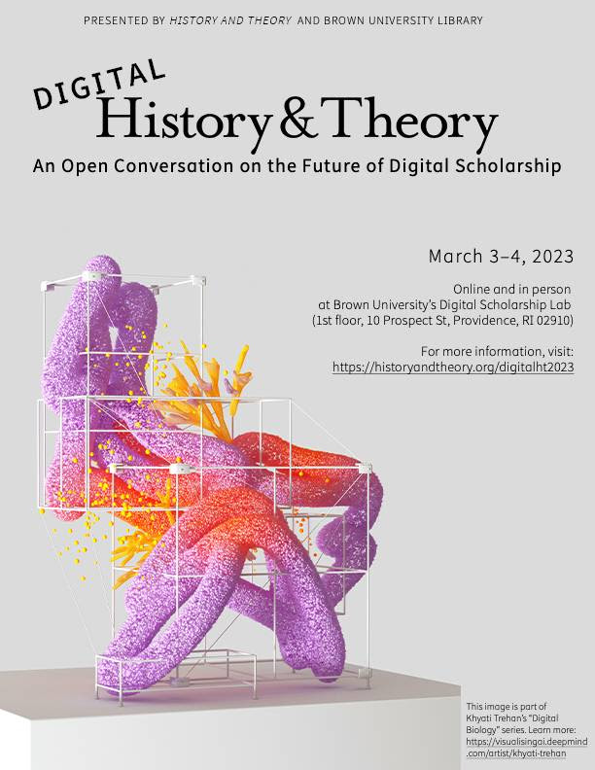

Slide 8


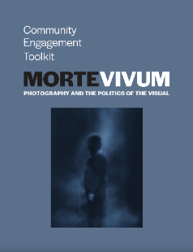

“It will change the way readers look at images of all kinds.” -- Aperture

Slide 9



Navigating Best Approaches and Practices
for a Digital Publishing Program in Micronesia

Slide 10



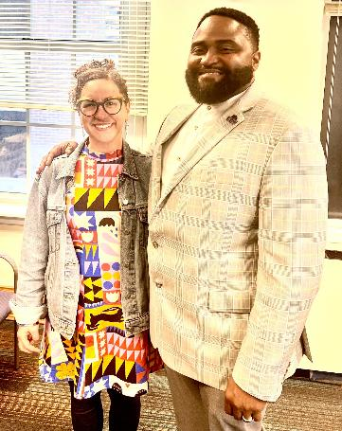
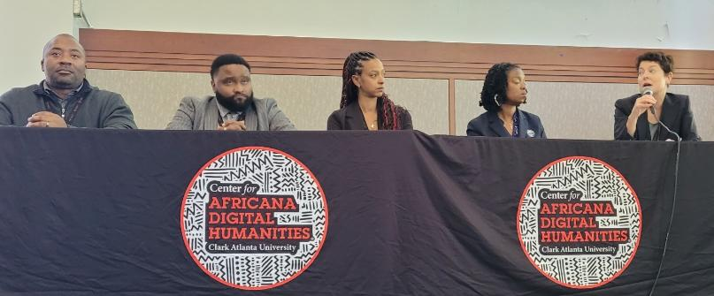

Slide 11

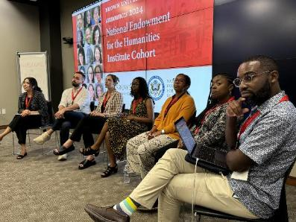
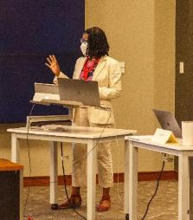
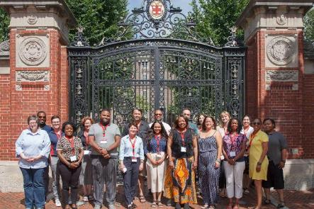
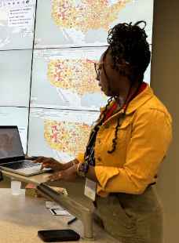
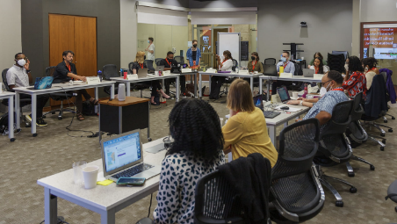
Notes:
.

Slide 12
